Slide 1
Artworks That Show Color

Slide 2
Primary Colors

Slide 3
Piet Mondrian
Broadway Boogie Woogie
1942-43

Slide 4
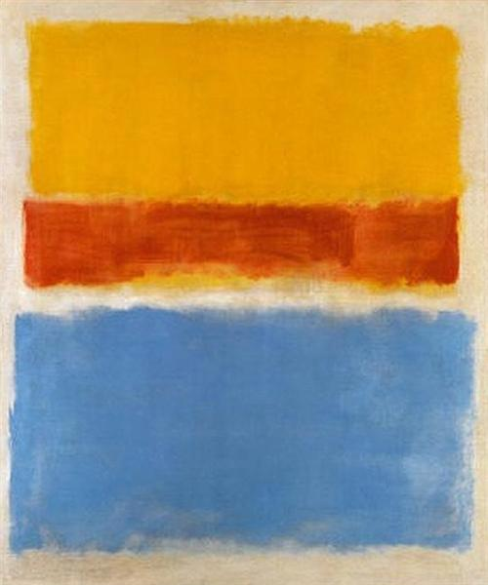
Mark Rothko
Untitled (Yellow, Red And Blue)
Date: 1953

Slide 5
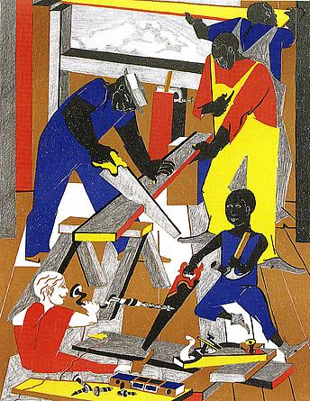
Jacob Lawrence
Workshop (Builders #1), 1972

Slide 6
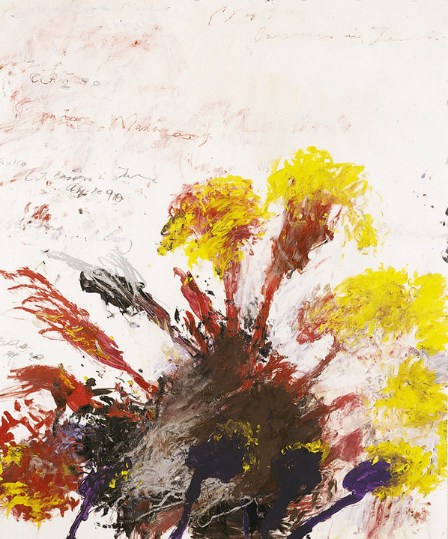
Cy Twombly
Summer Madness
1990

Slide 7
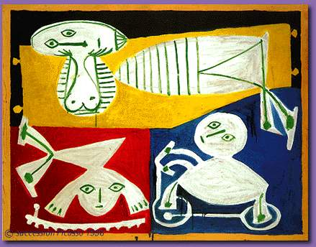
Pablo Picasso
Francoise Gilot With Paloma And Claude
Date: 1951

Slide 8
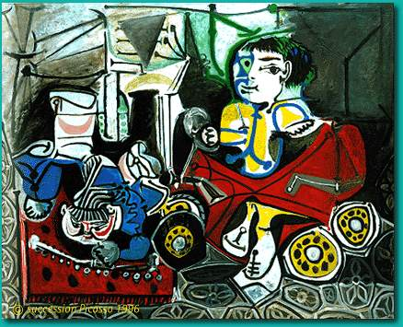
Pablo Picasso
Claude And Paloma Playing
Date: 1950

Slide 9
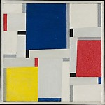
Fritz Glarner
Relational Painting Number 64 1953

Slide 10
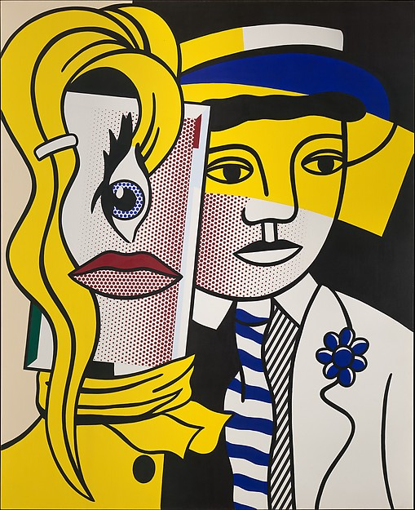
Roy Lichtenstein
Stepping Out
1978

Slide 11
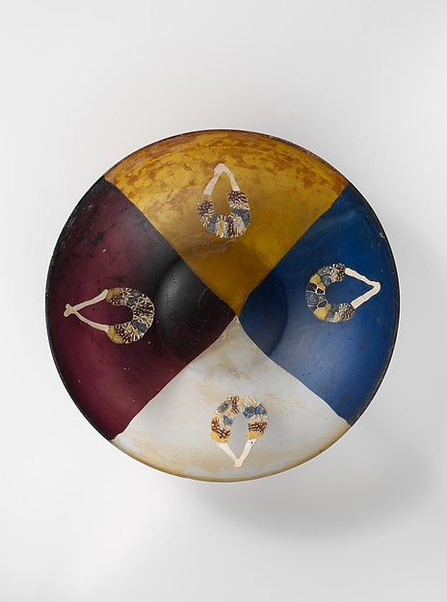
Glass garland bowl
late 1st century B.C.

Slide 12
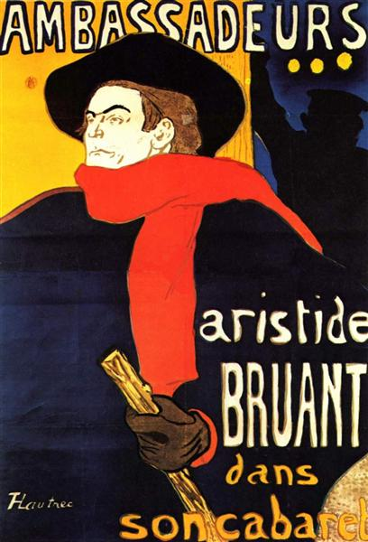
Henri de Toulouse-Lautrec
Ambassadeurs Aristide Bruant In His Cabaret
Date: 1892

Slide 13
Complementary Colors

Slide 14
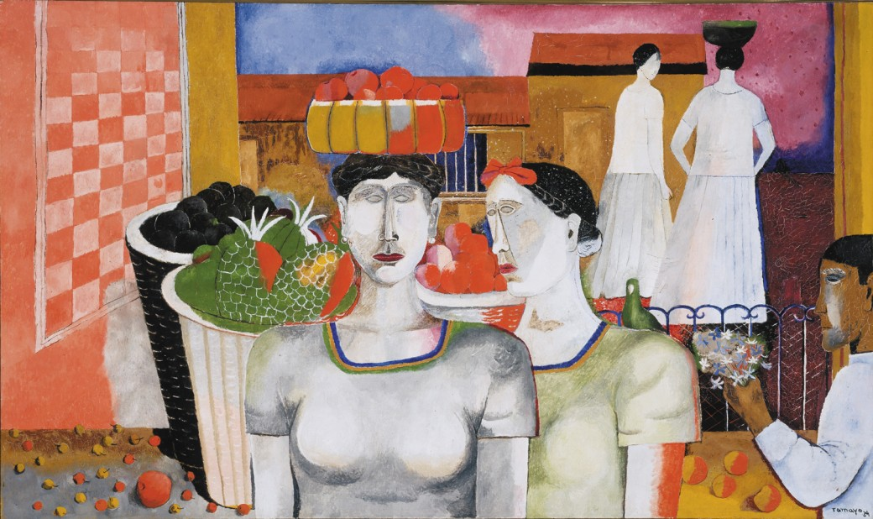
RUFINO tAMAYO
WOMEN OF TEHUANTEPEC
1939

Slide 15
Complimentary Colors Red and Green

Slide 16
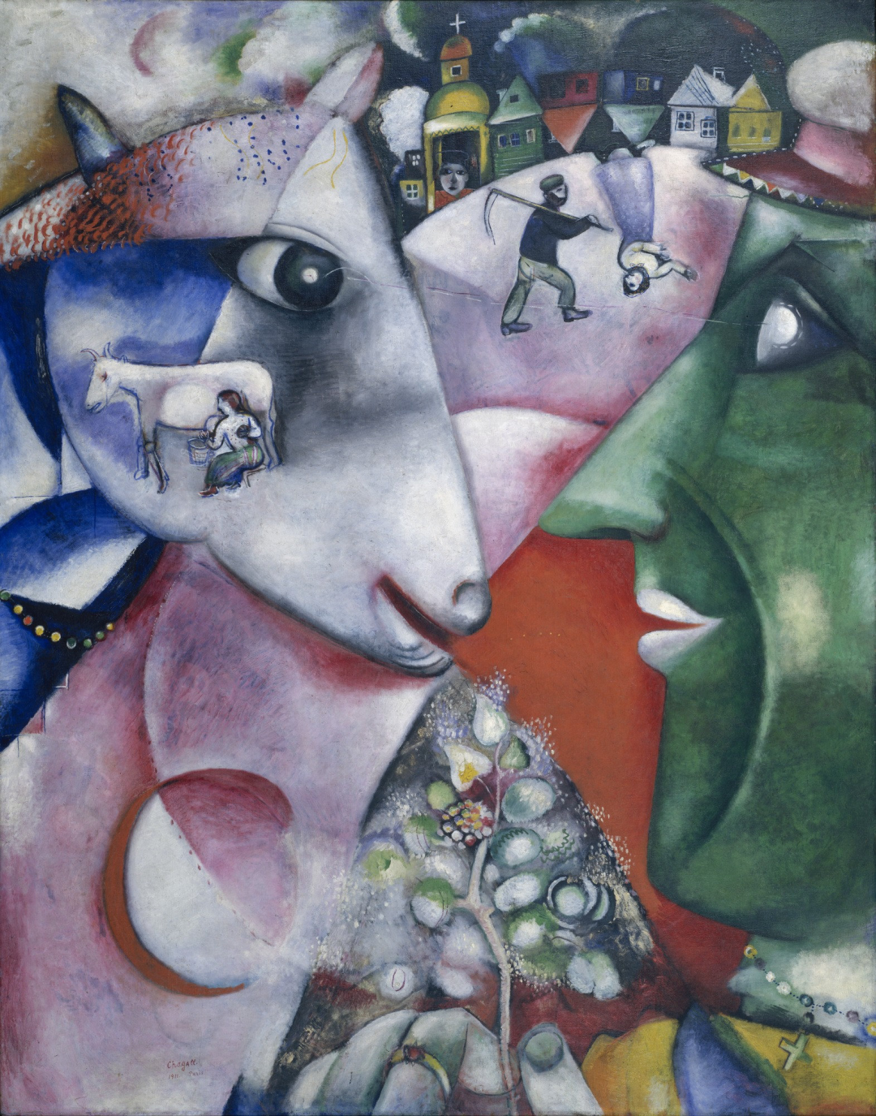
Marc Chagall
I and the Village
1911

Slide 17
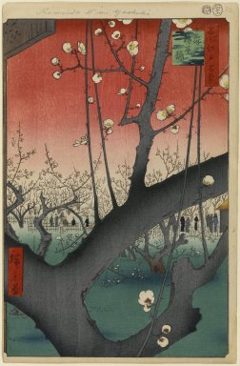
Utagawa Hiroshige (Ando)
Sleeping Dragon Plum
1857

Slide 18
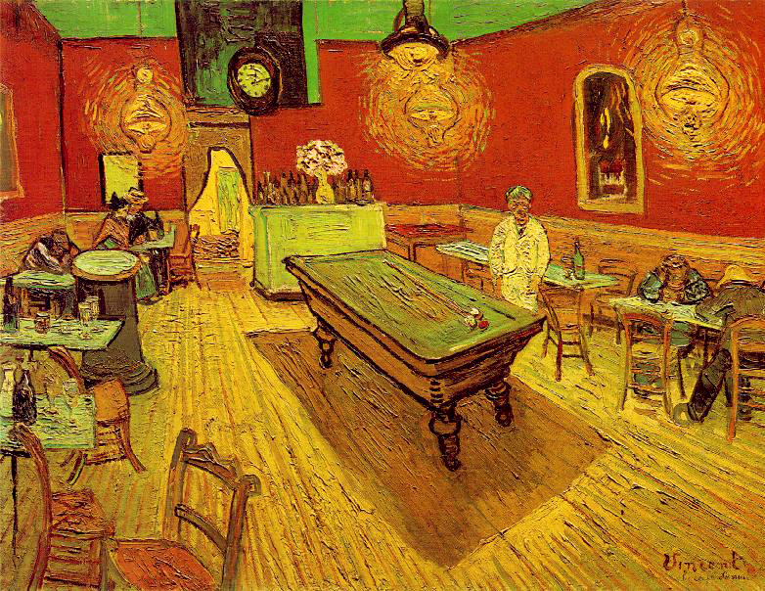
Vincent van Gogh
The Night Café
1888

Slide 19
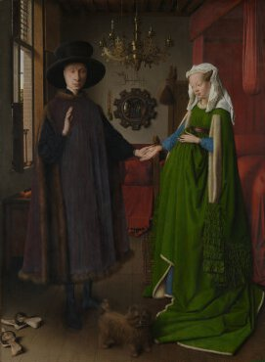
Jan van Eyck
The Arnolfini Portrait
1434

Slide 20
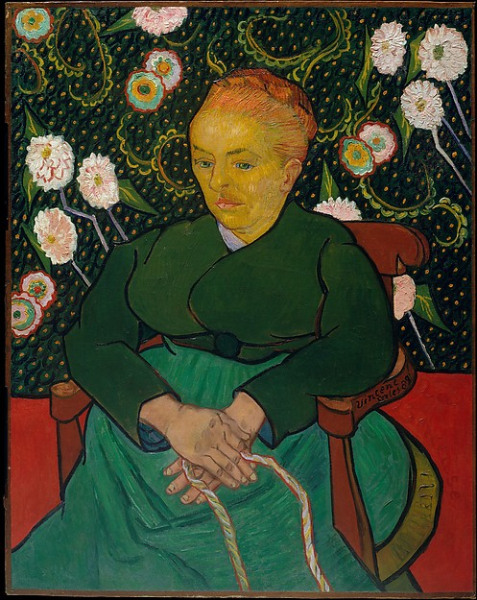
Vicent van Gogh
La Berceuse
(Woman Rocking a Cradle)
1889

Slide 21
Complementary Colors Blue and Orange

Slide 22
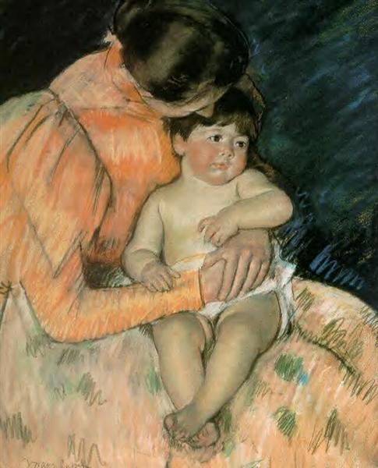
Mary Cassatt
Mother And Child
1890

Slide 23
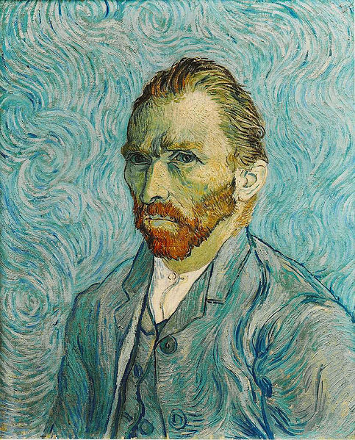
Vincent van Gogh
Self Portrait
1889

Slide 24
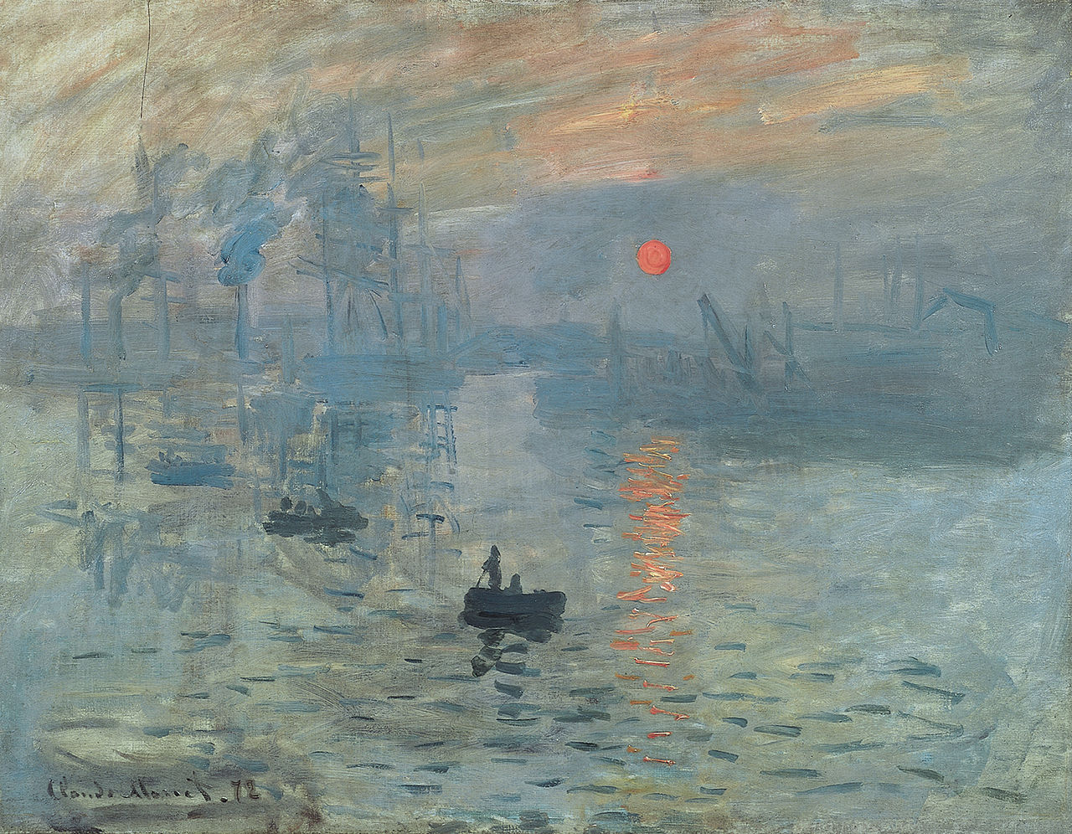
Claude Monet
Impression, Sunrise
1872

Slide 25
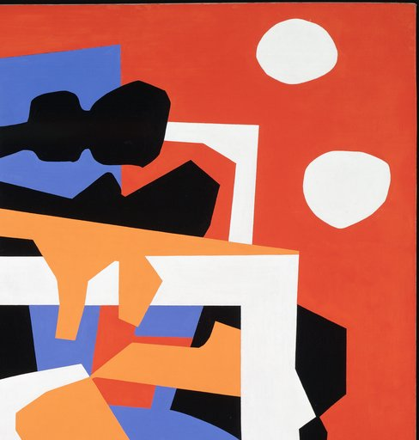
Stuart Davis
Colonial Cubism
1954

Slide 26
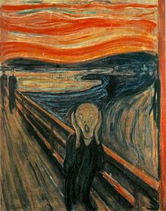
Edvard Munch
The Scream
1893

Slide 27
Complementary Colors Purple and Yellow

Slide 28
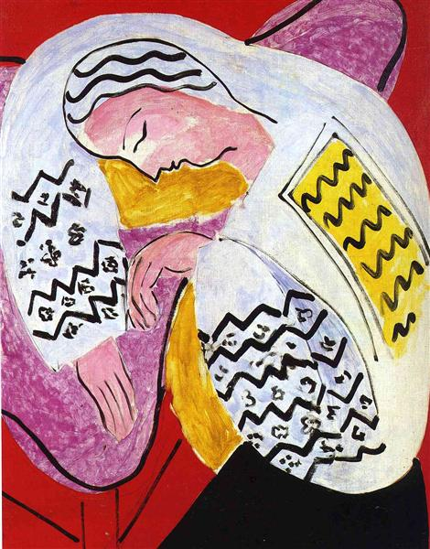
Henri Matisse
The Dream
Date: 1940

Slide 29
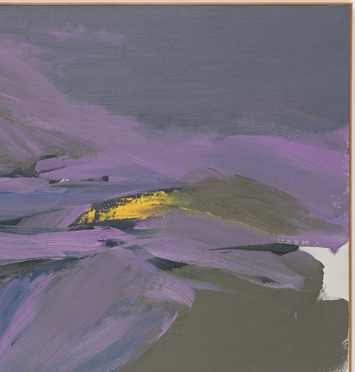
Ray Spillenger
Purple and Yellow
1963

Slide 30
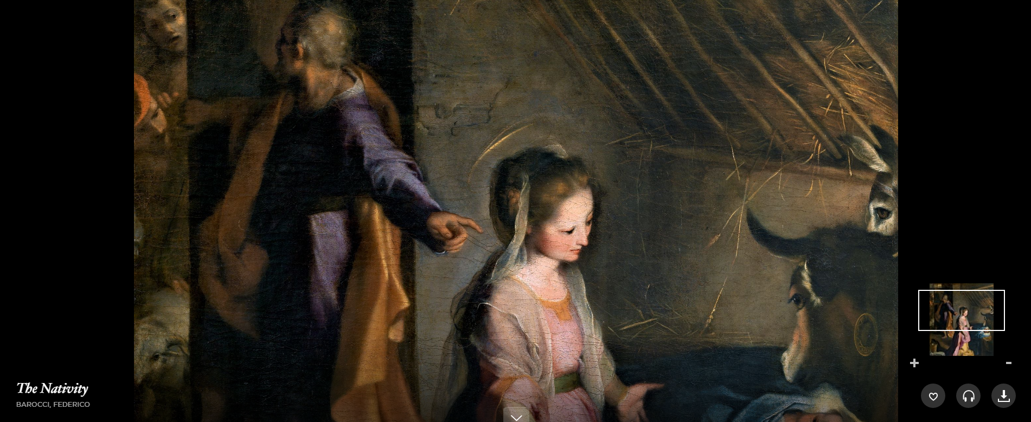
Federico Barocci
The nativity
1597

Slide 31
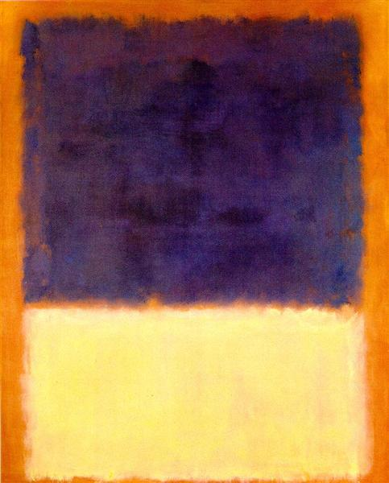
Mark Rothko
Red, Orange, Tan And Purple
Date: 1954

Slide 32
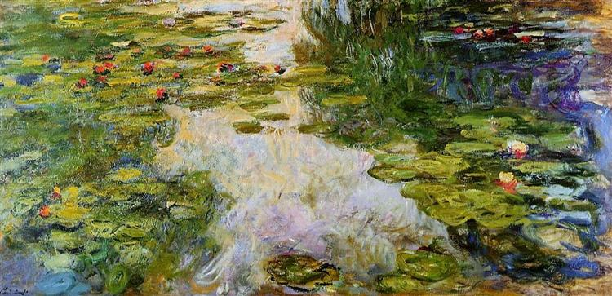
Claude Monet
Water Lilies
Date: 1917-1919

Slide 33
Analogous Colors

Slide 34
Josef Albers
Homage to the Square:
Soft Spoken
1969

Slide 35
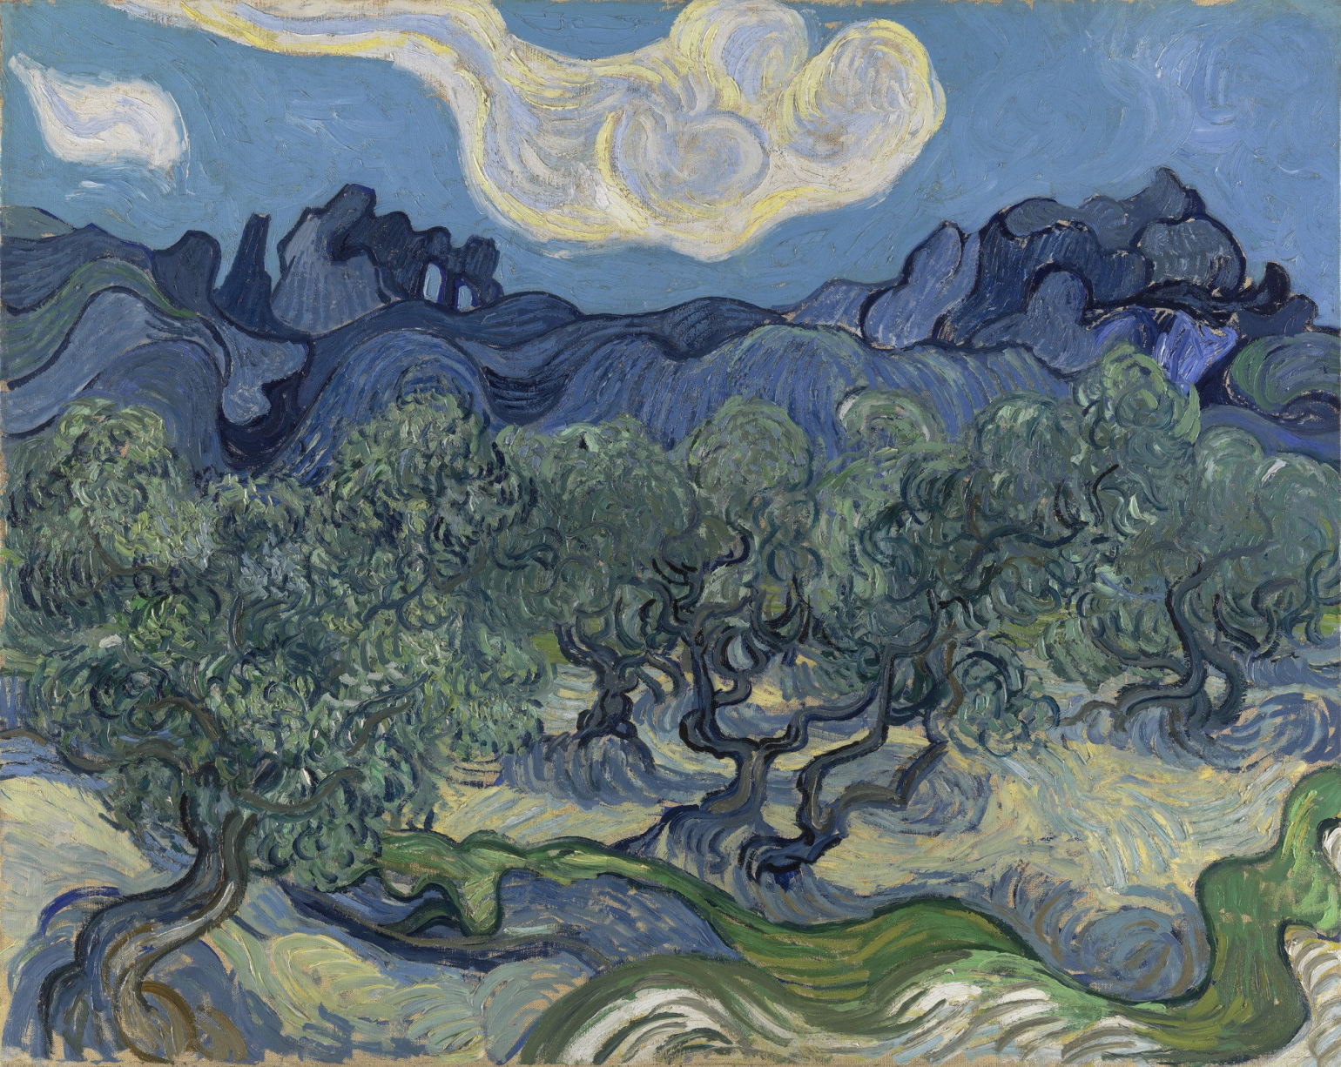
Vincent van Gogh
The Olive Trees
1889

Slide 36
Ed Paschke
Painted Lady
1995

Slide 37
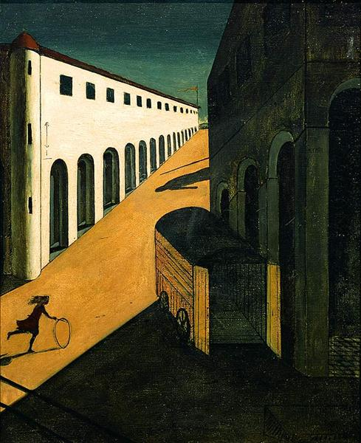
Giorgio de Chirico
Mystery And
Melancholy Of A Street
1914

Slide 38
Jean-Honoré Fragonard
Young Girl Reading
1770

Slide 39
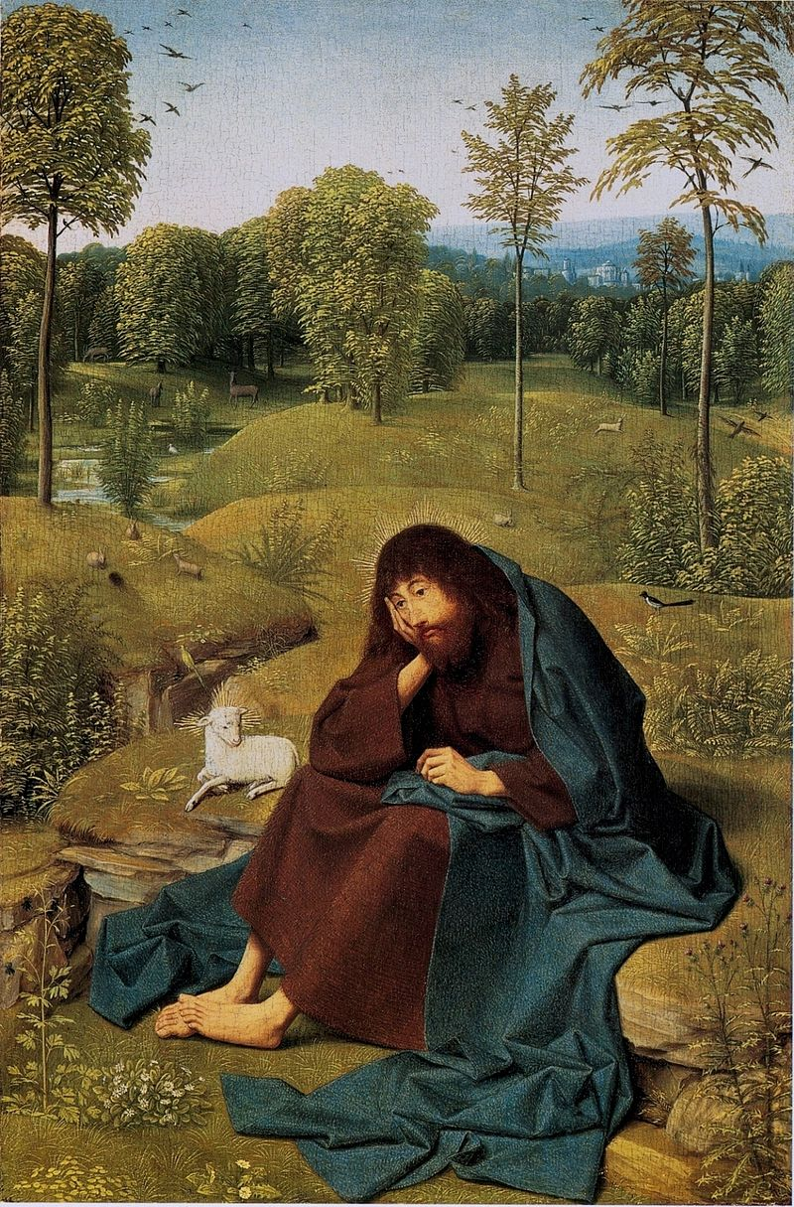
Geertgen Tot Sint Jans
John the Baptist in the Wilderness
1490

