Slide 1
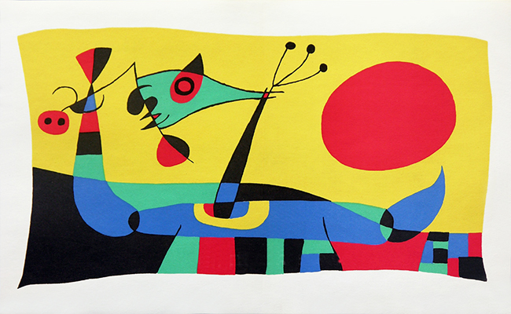
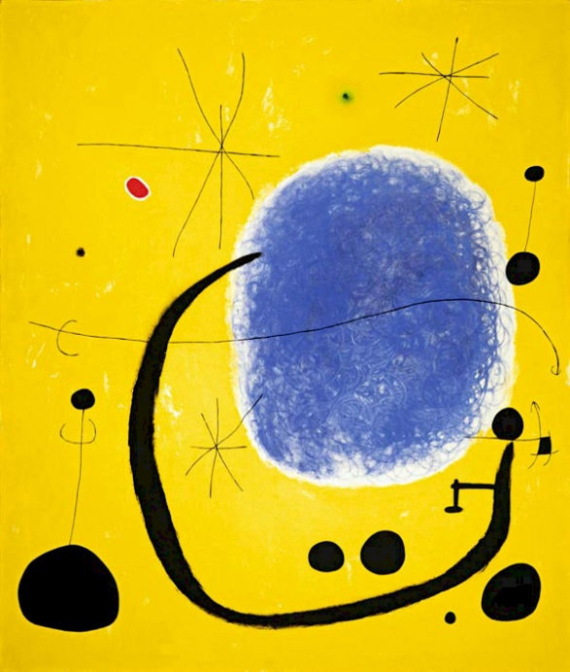
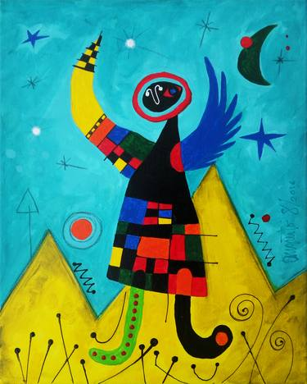
Joan Miro
Mi-ROH

Slide 2
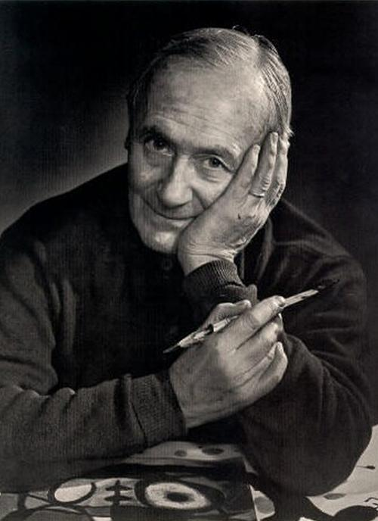
Born: 20 April 1893 Barcelona, Spain Died: 25 December 1983 (aged 90)

Slide 3
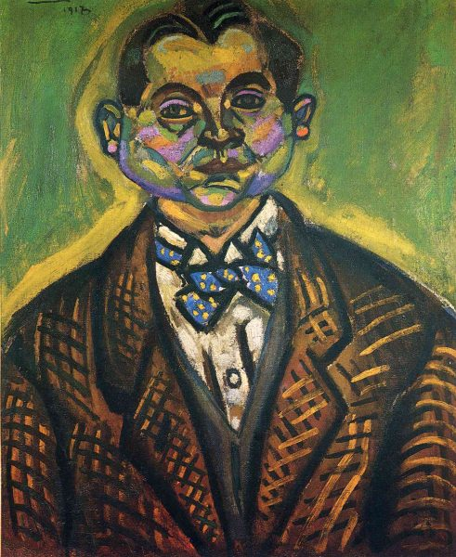
* He began drawing at age 13 * He enrolled at the fine arts academy against father’s wishes * He had his first solo show in 1918 at the Galeries Dalmau where his work was ridiculed and defaced. * How would you feel if your artwork was made fun of? Would you quit making art? He kept pushing forward and listened to his heart.

Slide 4
For 1300 years art was only considered valued if there were realistic looking things. Artists often painted people or objects and focused on how light and shadows made the objects look 3-dimentional.

Slide 5
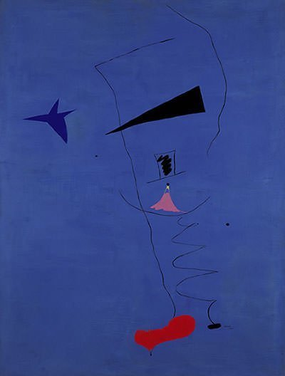
Nearly 150 years ago, artist started changing the way we look at art. They started focusing on concepts and non-realistic looking things. Instead of focusing on the skill of light and shadows, they focused more on emotions and colors. Check out this artwork from Joan Miro. It meant one thing to him. But the longer you look at it, it may mean something different to you. And it might make you feel a certain way by looking at it.

Slide 6
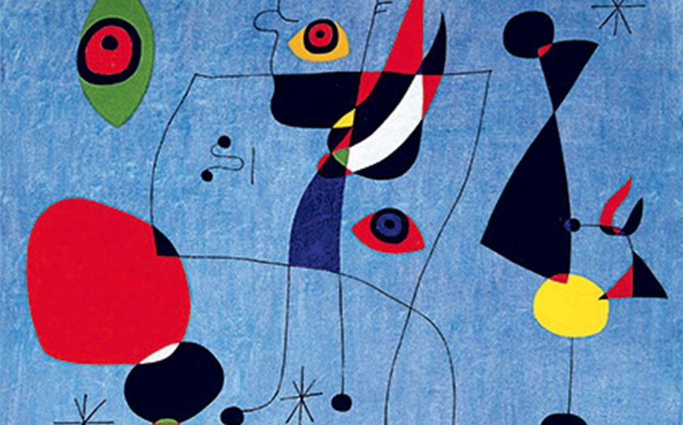
Surrealism 1917-1950
The type of art that Miro made became known as surrealism. Do you see the word real in it’s name? It really means that it isn’t real looking at all. The definition for surrealism is that it can ”release the creative potential.” This means that you can make art based on an experience you have had or on how you feel. Or you can make art to encourage others to feel something. Sometimes artists even made art because of something that happened in their dreams. Check out all the interesting shapes and colors in this artwork by Miro.
This piece is called, “Femmes et oiseau dans la nuit”
Which means, “Women and birds at night”

Slide 7
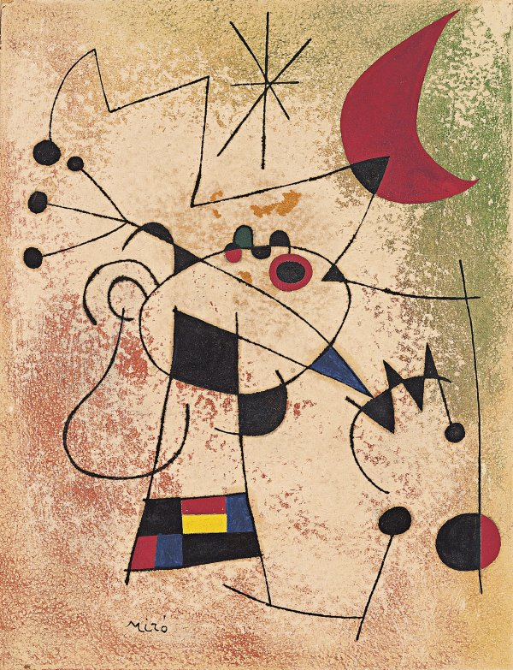
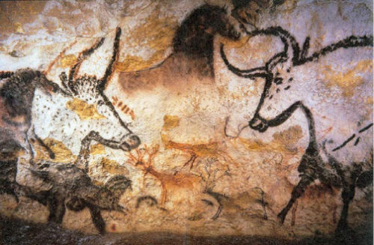
Joan grew up in Catalonia, Spain. In Catalonia they have famous cave paintings. Miro also loved children’s artwork. He was inspired to make art like the cave paintings and children's art he saw. Can you find the similarities in his artwork and the cave painting next to it? What shapes and colors do you see?

Slide 8
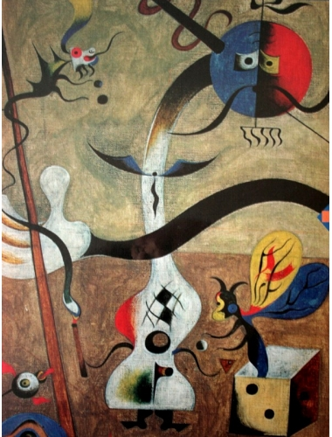
His artwork sold for between $250,000 and $26 million His artwork didn’t have a plan. Instead it was based on randomness and chance. Check out this close up on the next painting on the next slide. This is supposed to be an image of a man who is hungry. Do you see the hole in his stomach?

Slide 9
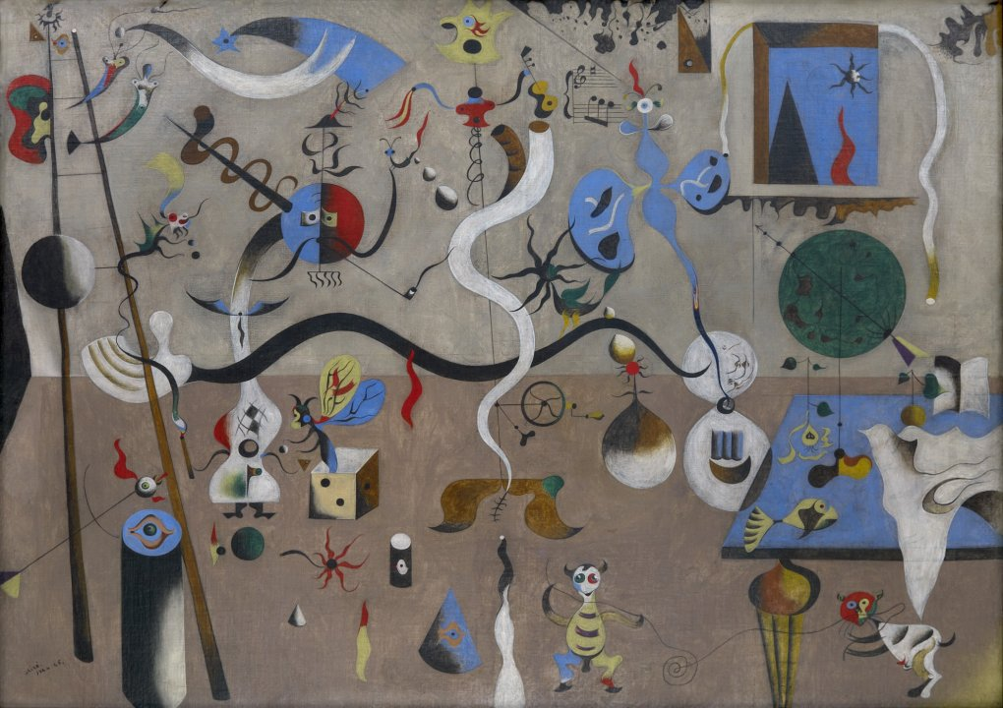
Harlequin's Carnival 1924-1925

Slide 10
Joan Miro Artwork
The following slides have some of his famous paintings. You can Google him and check out even more online.
As you look at each image, notice his style over the years.
Do you think his artwork changes or stays the same? Do the colors and shapes change or stay the same?

Slide 11
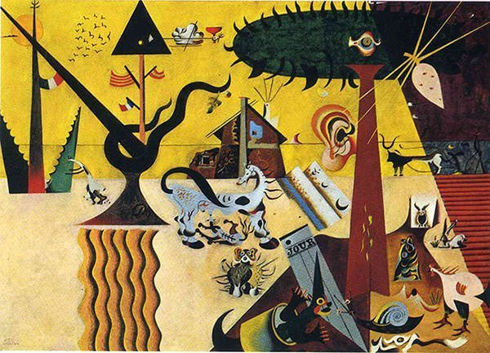
The Tilled Field (1923)

Slide 12
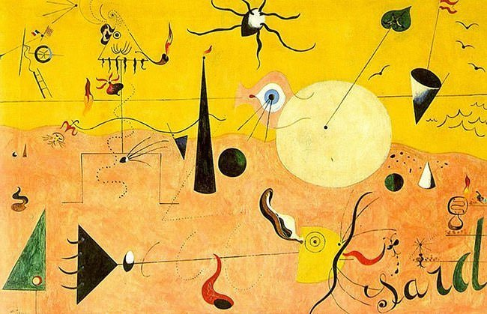
Catalan Landscape (1924)

Slide 13
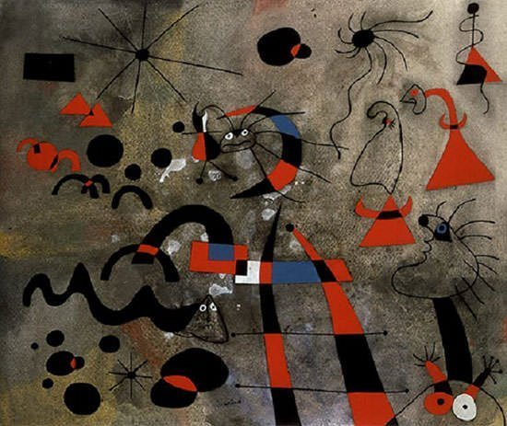
The Escape Ladder (1940)

Slide 14
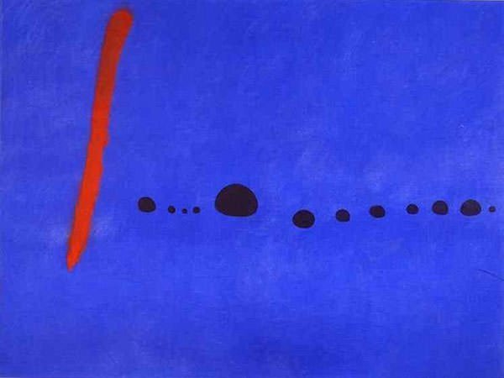
Blue II (1961)

Slide 15
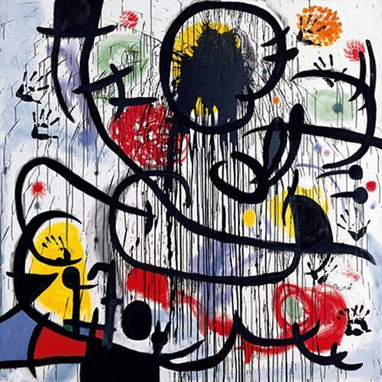
May 1968 (1973)

Slide 16
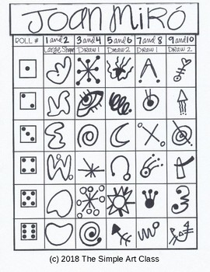
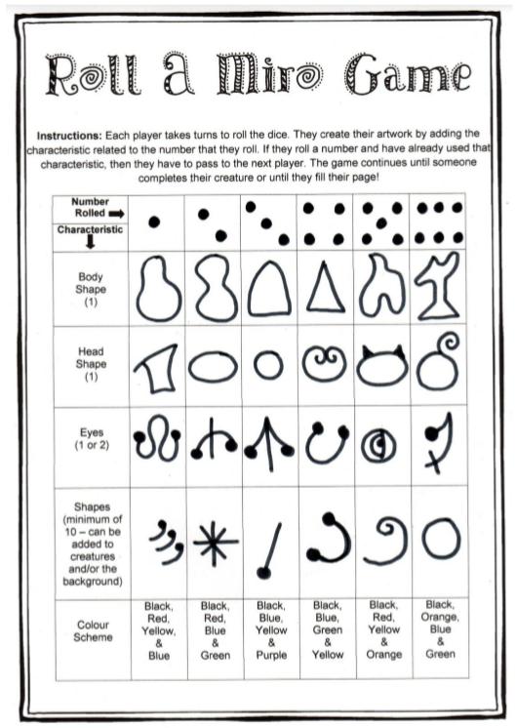
In the early 1920s, Miro created a picture language which would be central throughout the rest of his career. Here are three different guides to use. Look at these to help you create your own artwork. You may roll a dice to make your artwork or just choose from the images. I challenge you to do this with a sharpie…no pencils. The idea is to make some of the images very large and other ones smaller. Repeat some of the images. Have fun. Let your imagination guide you. Maybe your artwork tells a story. Maybe it shares how you are feeling. Send me some of your finished drawings!

Slide 17
End

