Slide 1
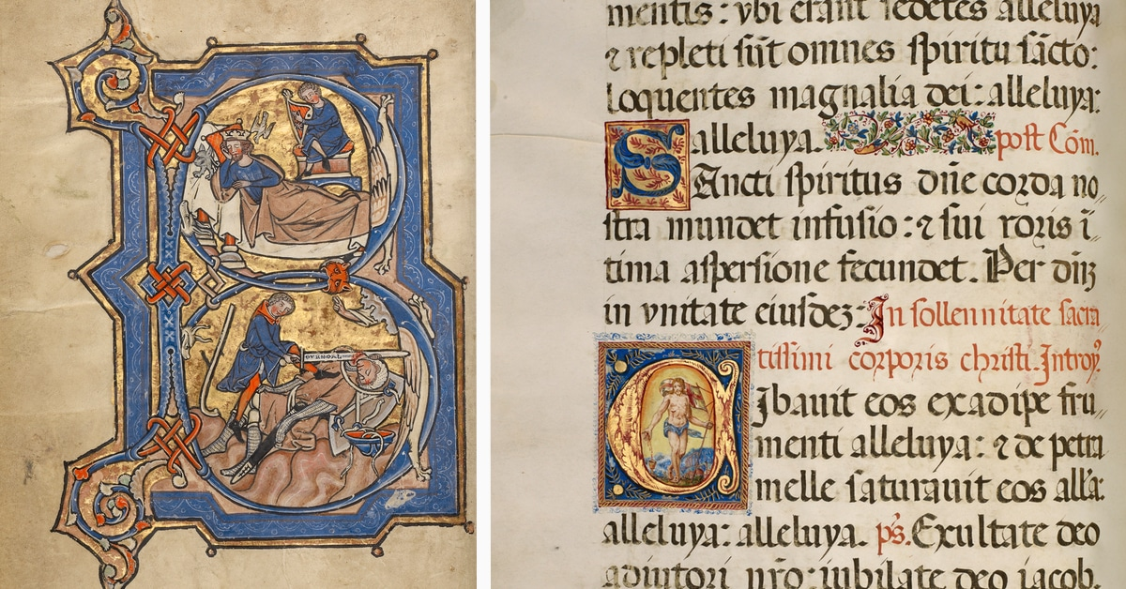
Illuminated Manuscripts

Slide 2
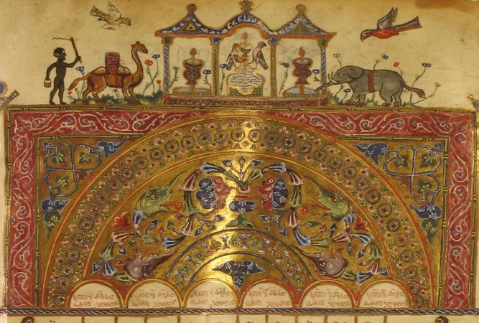
Illuminated Manuscripts
Manuscript (means written by hand) with an addition of decoration or illustration
Addition of silver or gold
Religious in nature
For more than 1,000 years (500-1500AD) years they brought scripture, stories, myths, and legends to life
Made of Calf skin – vellum (400AD)

Slide 3
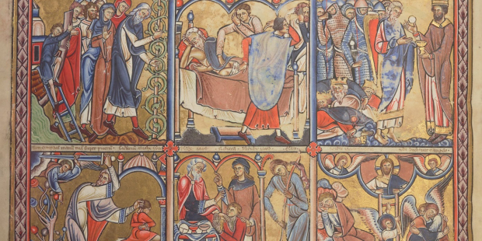
Comics
The comic strip of its day…image stories
Many people were uneducated and couldn’t read and this gave the opportunity to spread Jesus’ message

Slide 4
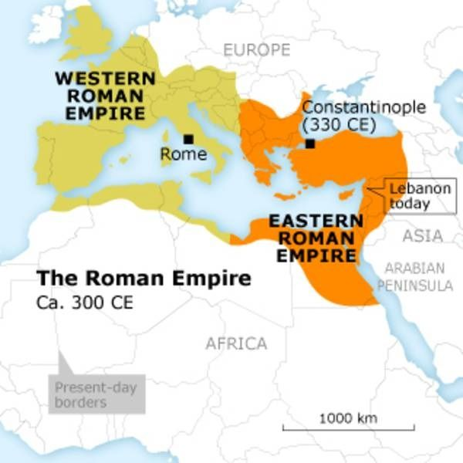
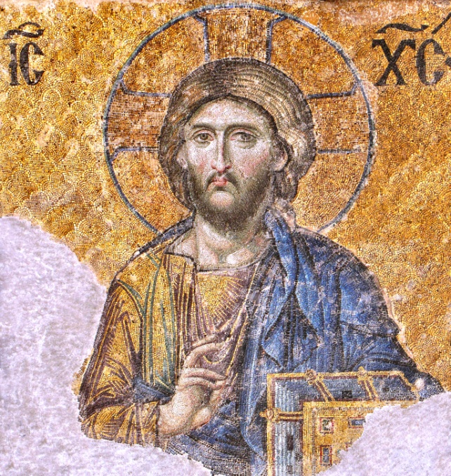
Origins
330AD - Constantine transferred the Capital of the World
from Rome to Byzantium (New Rome). Greek influences
Craftsmen of New Rome reached the highest level of technical skill and decorative beauty
Constantinople became, for several centuries, the chief centre for the production of manuscripts of all kinds.

Slide 5
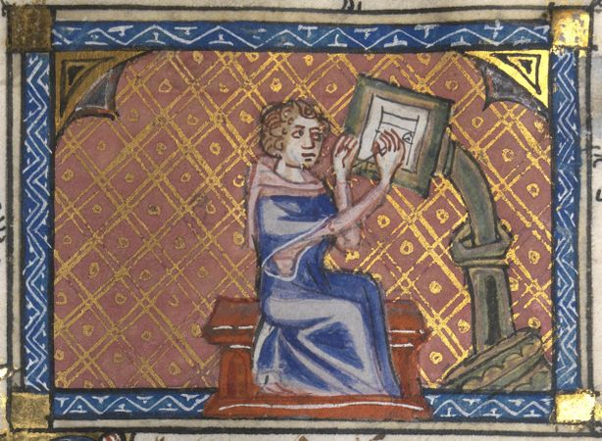
Origins
4th and 5th centuries Monks in Italy began to illustrate their books
By 500AD St. Benedict focused on “work” as much as “prayer” in monasteries
As Monks also became missionaries, they were now spreading the word and image of God
Ultimately they helped convert England to Christianity
These manuscripts gave rise and power to monasteries which continued to spread The Word of God

Slide 6
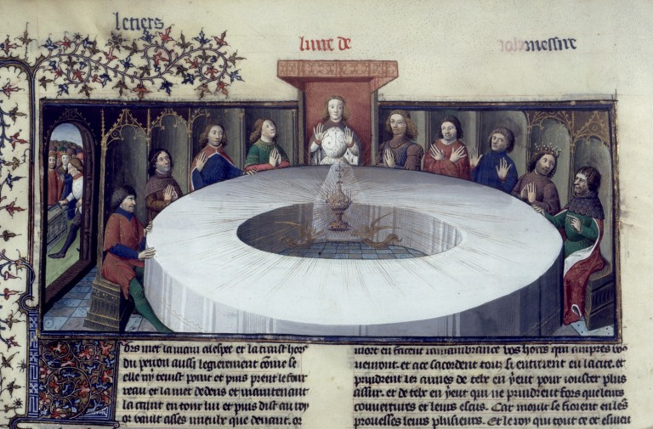
400s - 1400s
Jesus and His Disciples
King Arthur and His Round Table

Slide 7
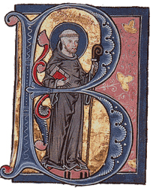
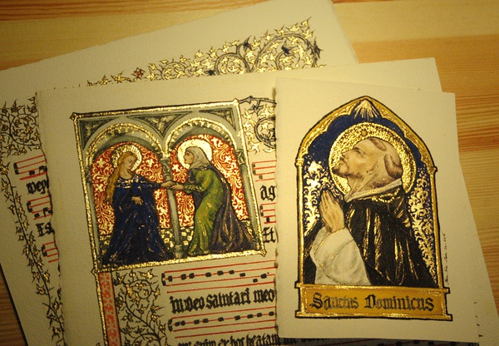
Facts
Decorated initials, borders and miniatures
Became like a multimedia experience
Guide for the Latin Mass
See the images and understand the solemnity

Slide 8
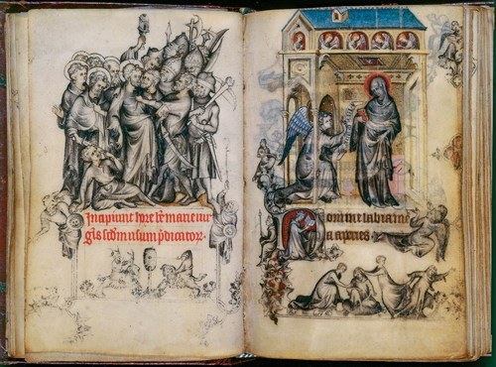
Facts
Explanation, illustration, decoration, information, glorification – added value to word of God
Each leaf could take months to complete
The most popular type of illuminated manuscript was the Book of Hours, which was comprised of Christian prayers to be said at certain hours throughout the day.

Slide 9
Art Movements

Slide 10
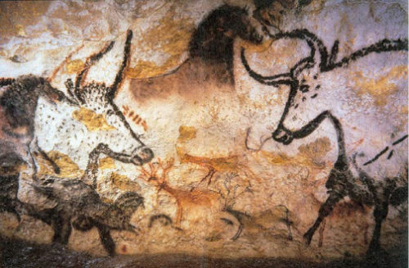
Pre-historic 40,000 BC - 4,000 BC
40,000 years

Slide 11
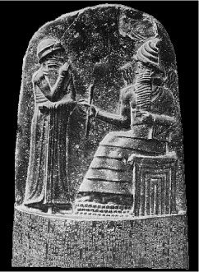
Ancient Art 30,000 BC - 400 AD
30,000 years

Slide 12
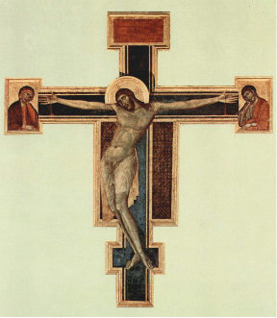
Medieval Art 500-1400
1,000 years

Slide 13
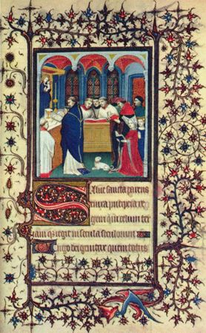
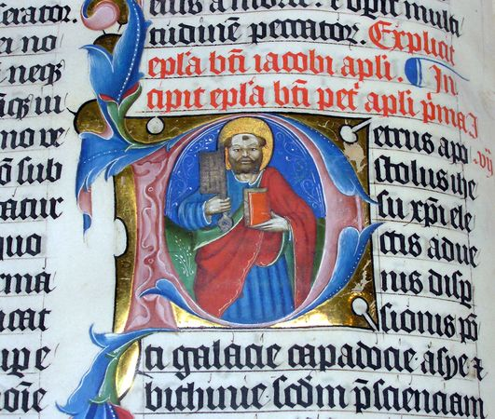
Illuminated Manuscripts

Slide 14
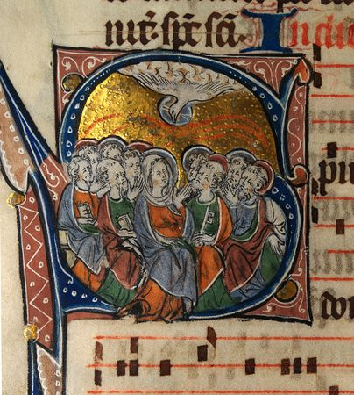
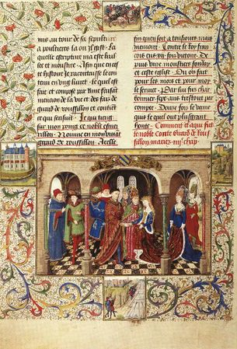
Illuminated Manuscripts

Slide 15
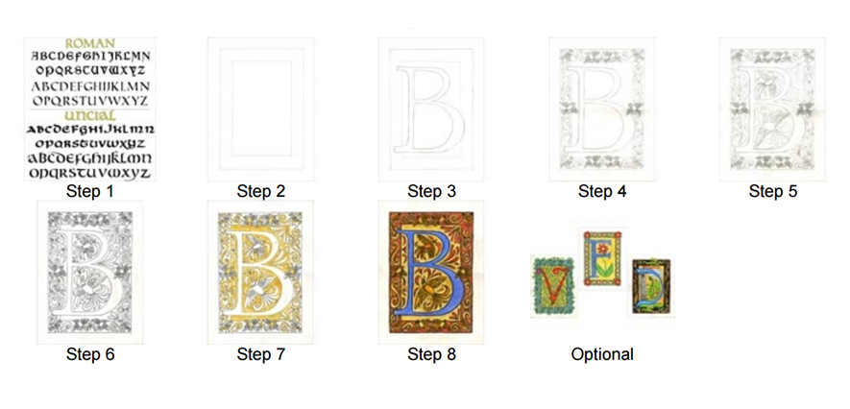
Steps

Slide 16
