Slide 1
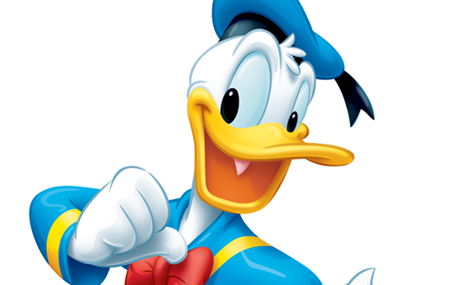
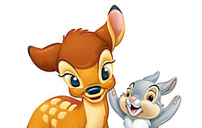
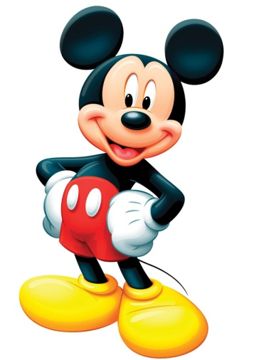
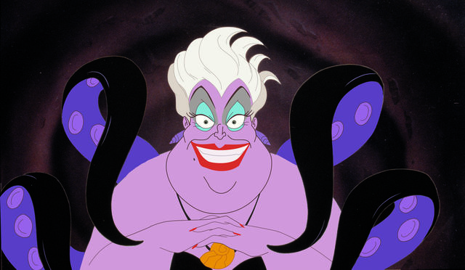
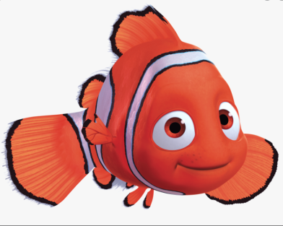
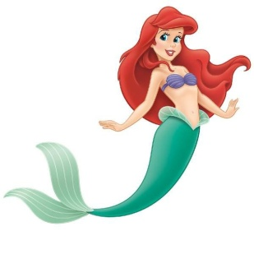
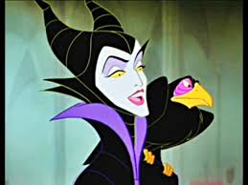
Color Theory for kids inspired by Disney
LeahNewtonArt.com

Slide 2
Sir Isaac Newton created “color theory.” He invented the Color Wheel in 1666.
Color Theory uses both science and art.
It is a guide for mixing colors, and how to use combinations of them for a visual effect.

Slide 3
Vocabulary
Primary – pry-merry (red, yellow, blue)
Secondary – second-ary (orange, green, purple (violet)
Tertiary – ter-she-ary (red/orange, orange/yellow, yellow/green etc)
Neutral – new-tral (brown, black, gray, white)
Complimentary – com-pli-ment-ary (red/green, orange/blue, yellow/purple)
Analogous – ah-nah-low-gus (colors in order on the color wheel in groups)

Slide 4
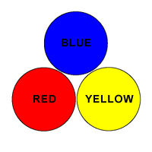
Primary Colors Red – Yellow – Blue

Slide 5
List as many Disney characters that you can think of that are mostly Red, Yellow and/or Blue. You may also choose characters and their friends from the same film.
1.
2.
3.
4.
5.
Hint: Here is an example to get your brain working. Mickey Mouse

Slide 6
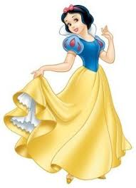

Slide 8
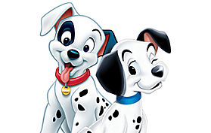

Slide 9
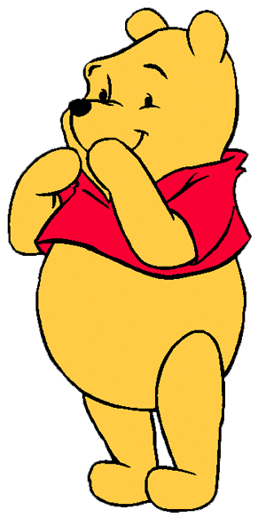

Slide 10
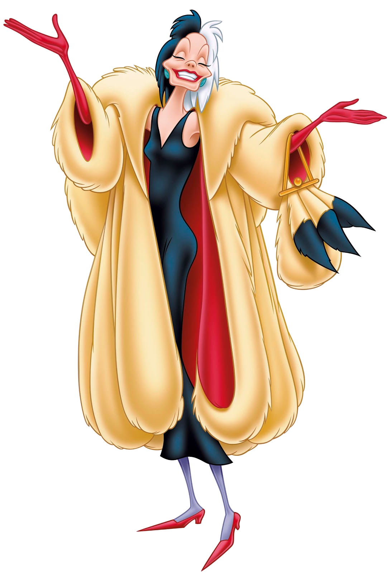

Slide 11
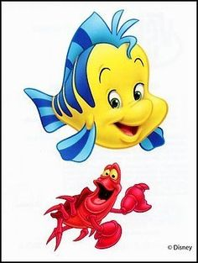

Slide 12
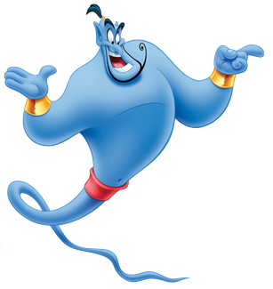

Slide 13
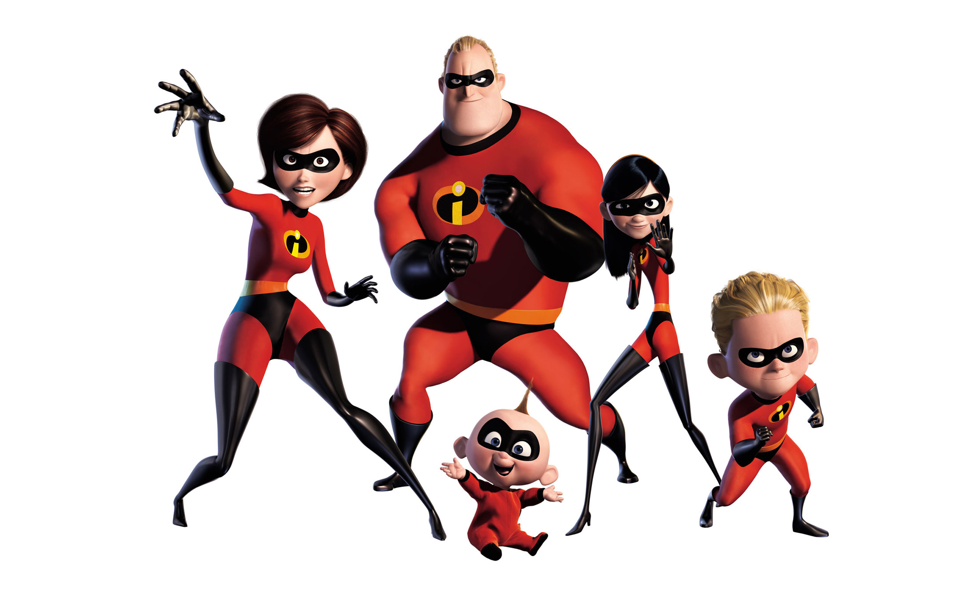

Slide 14
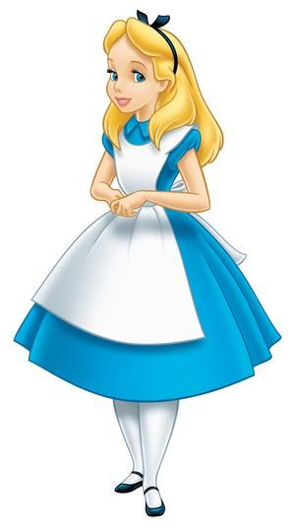
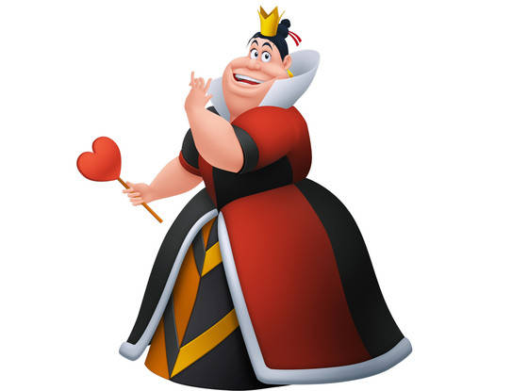

Slide 15
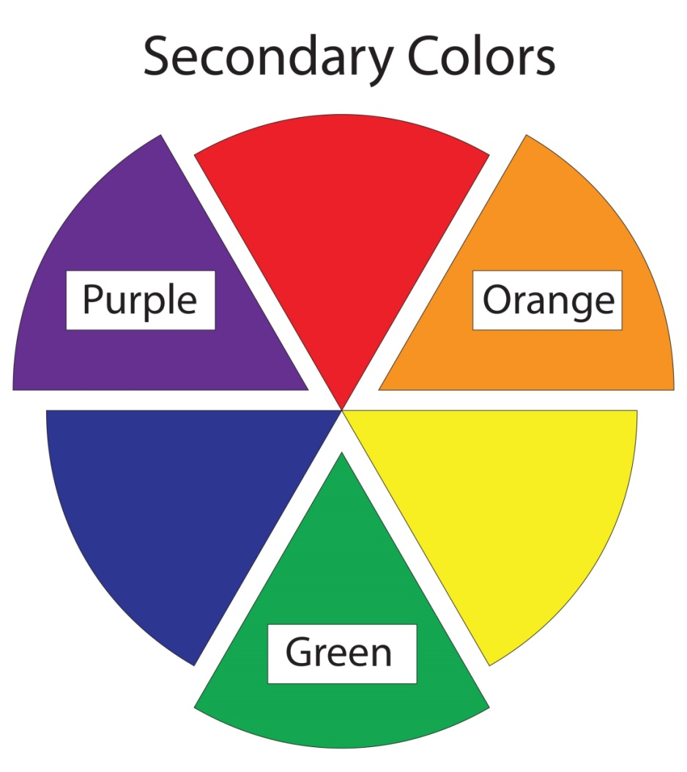
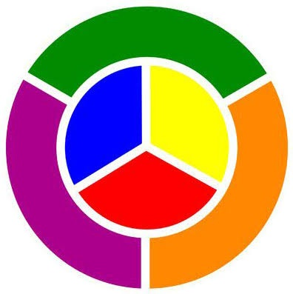
Secondary Colors Orange – Green – Purple

Slide 16
List as many Disney characters that you can think of that are mostly Orange, Green and/or Purple. You may also choose characters and their friends from the same film.
1.
2.
3.
4.
5.

Slide 17
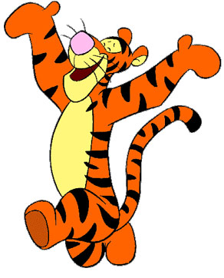

Slide 19
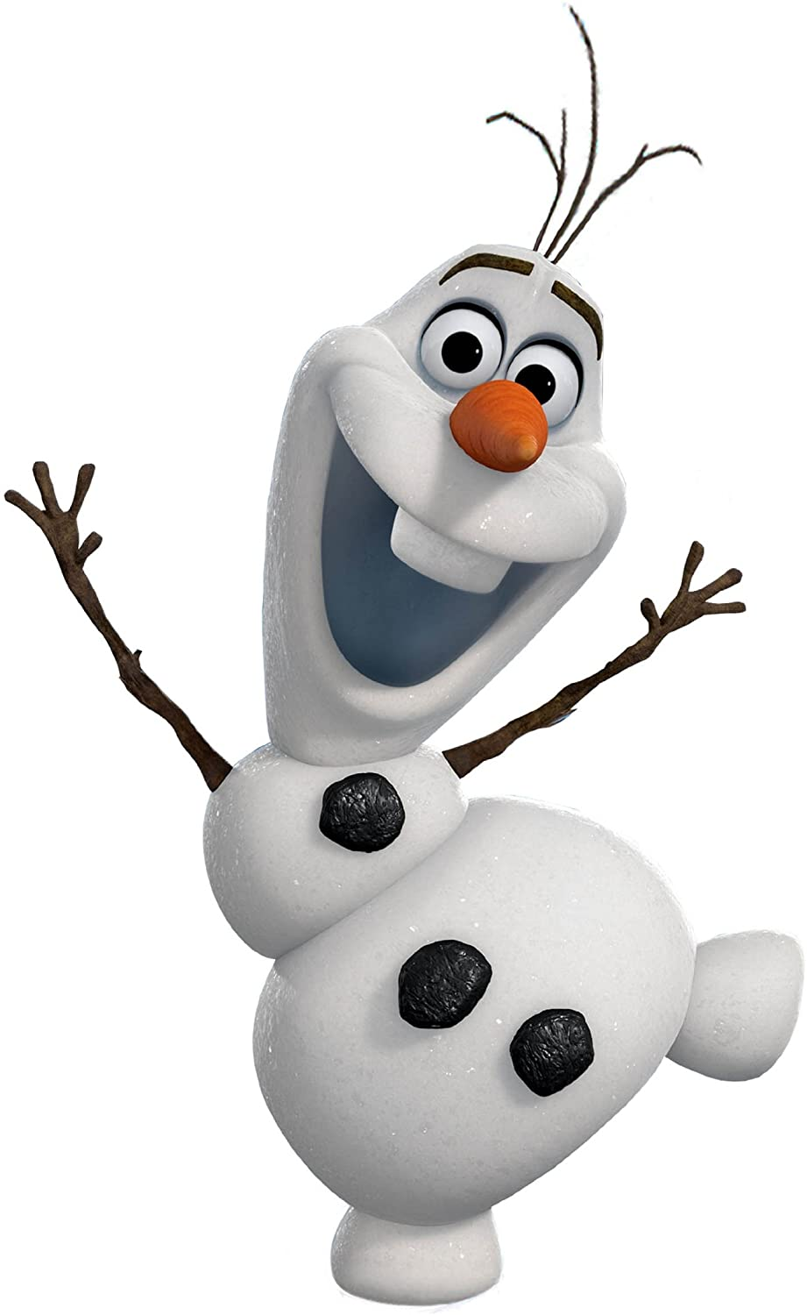

Slide 21
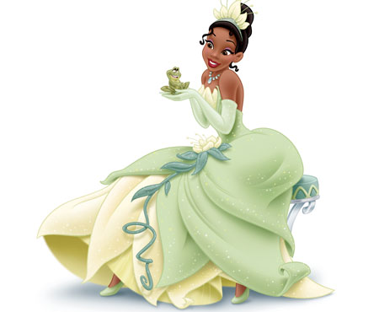

Slide 22
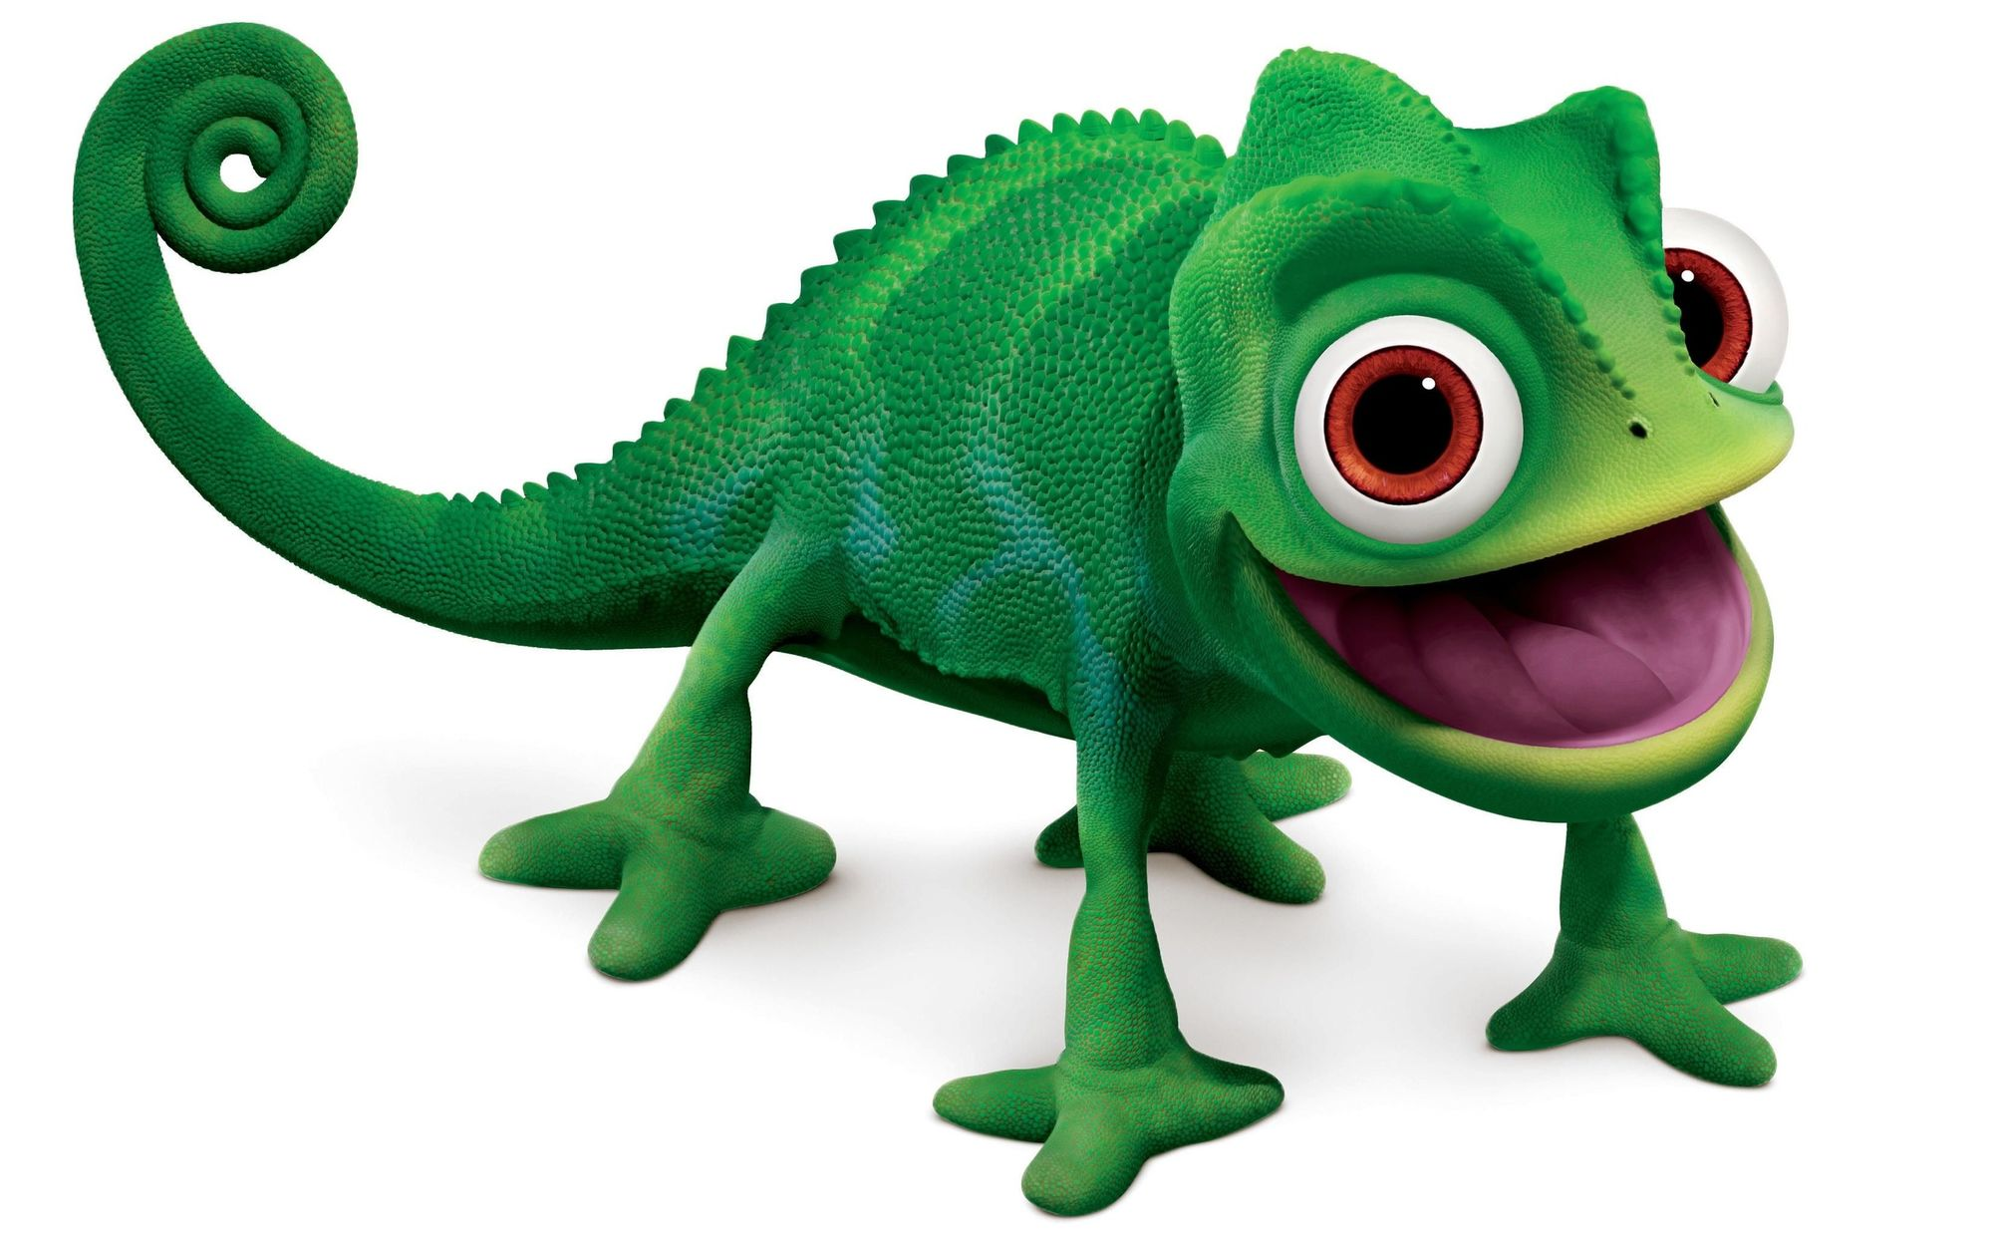

Slide 23
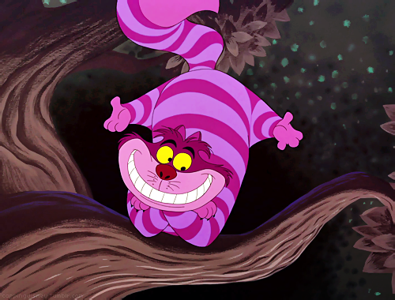

Slide 24
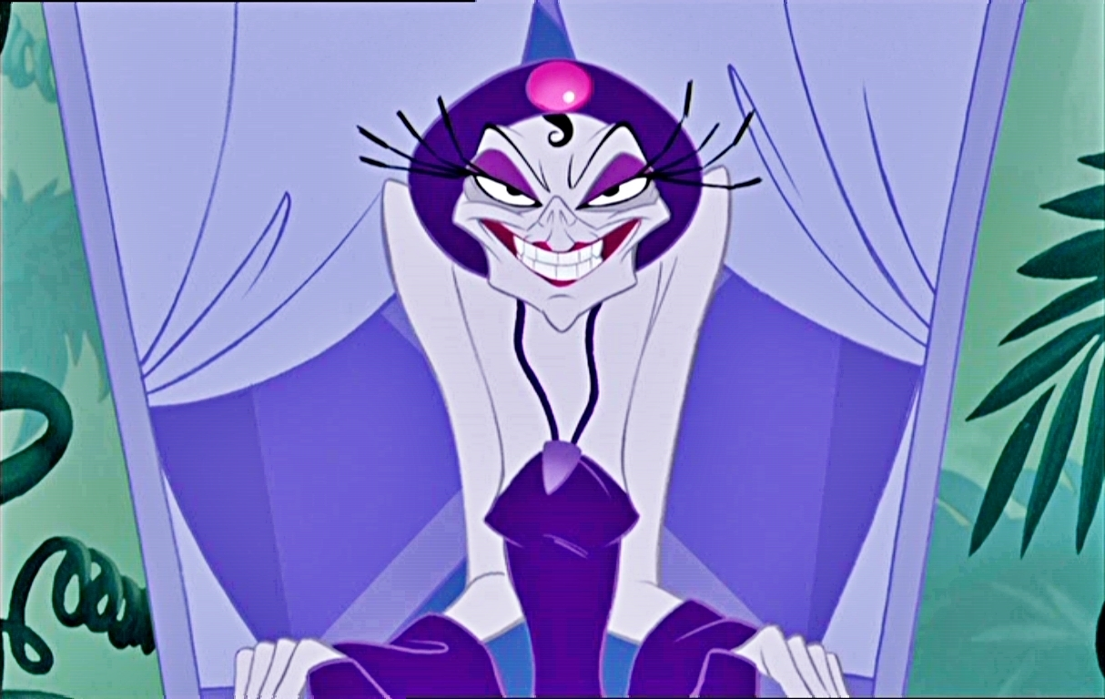

Slide 26
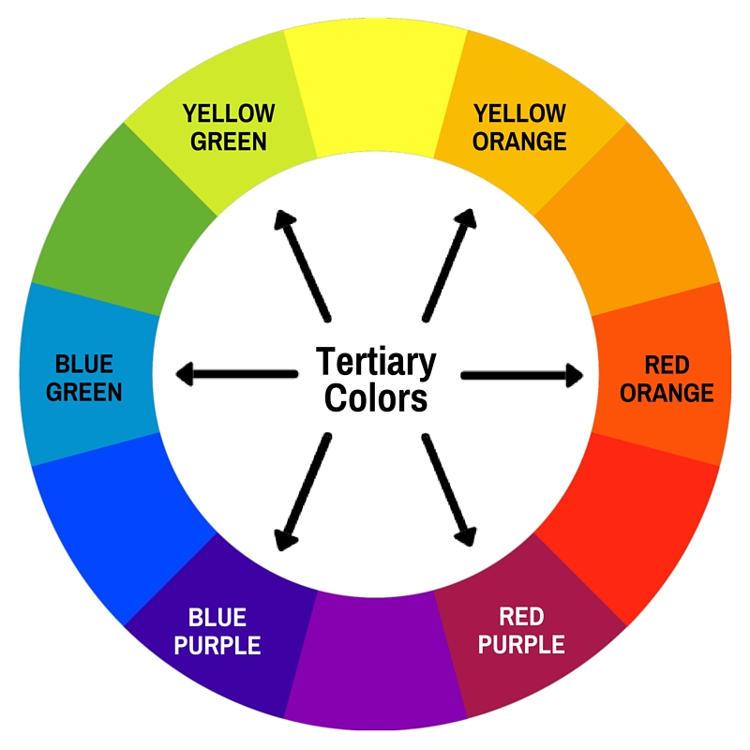
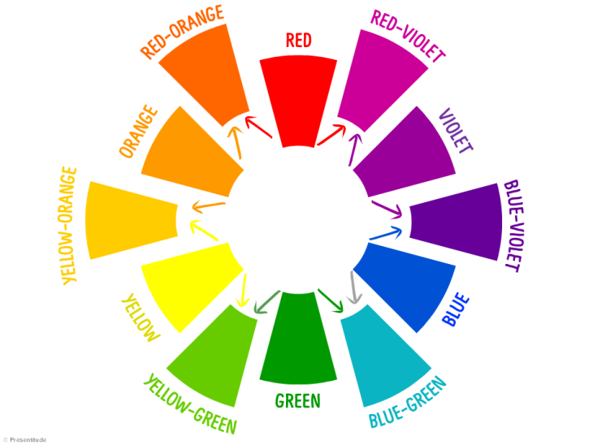
Tertiary Colors Marigold – Tiger -Magenta - Indigo - Aquamarine - Lime

Slide 27
List as many Disney characters that you can think of that are mostly Red/Orange – Orange/Yellow – Yellow/Green – Green/Blue – Blue/Violet – Violet/Red. You may also choose characters and their friends from the same film.
1.
2.
3.
4.
5.

Slide 28
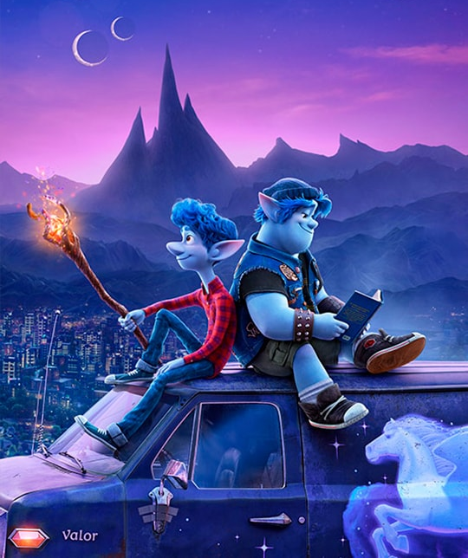

Slide 29
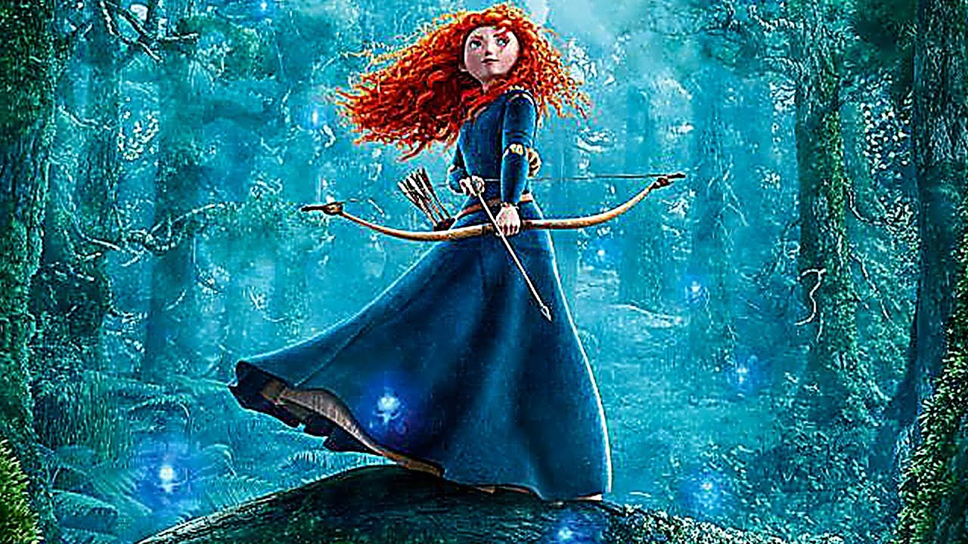

Slide 30
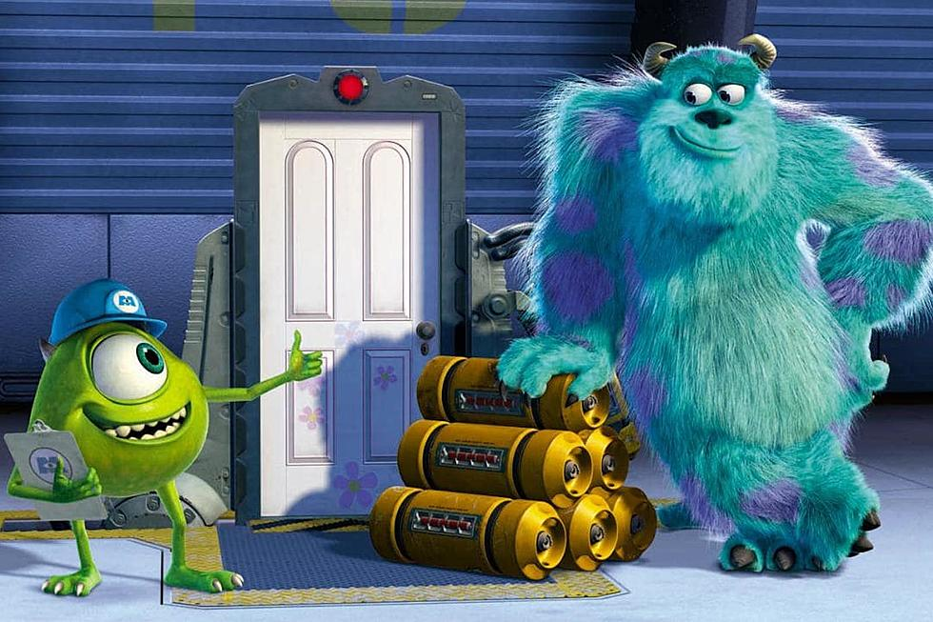

Slide 31
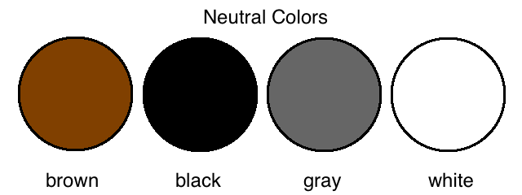
Neutral Colors Brown – Black – Gray – White
Neutral colors don't show up on a color wheel.

Slide 32
List as many Disney characters that you can think of that are mostly Brown, Black, Gray and/or White. You may also choose characters and their friends from the same film.
1.
2.
3.
4.
5.

Slide 34
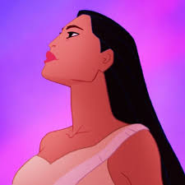

Slide 35
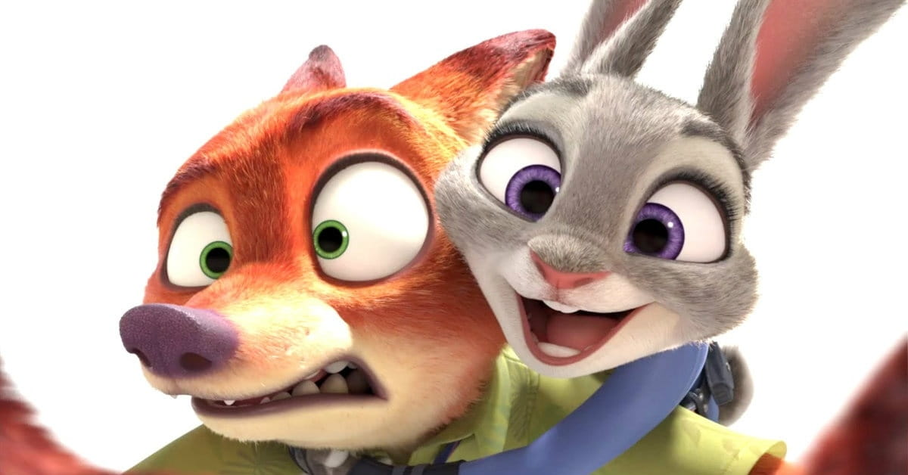

Slide 36
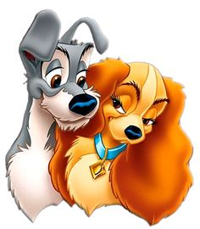

Slide 37
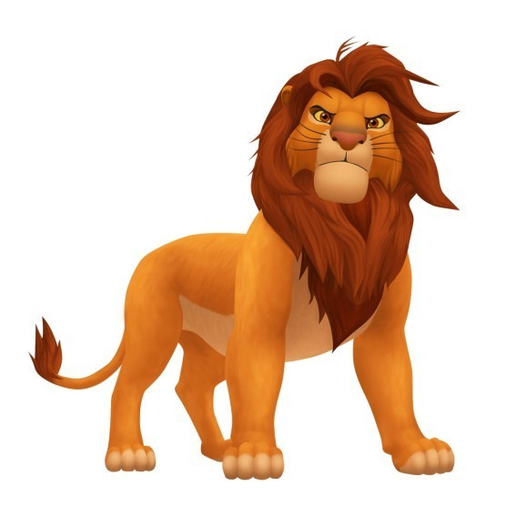

Slide 38
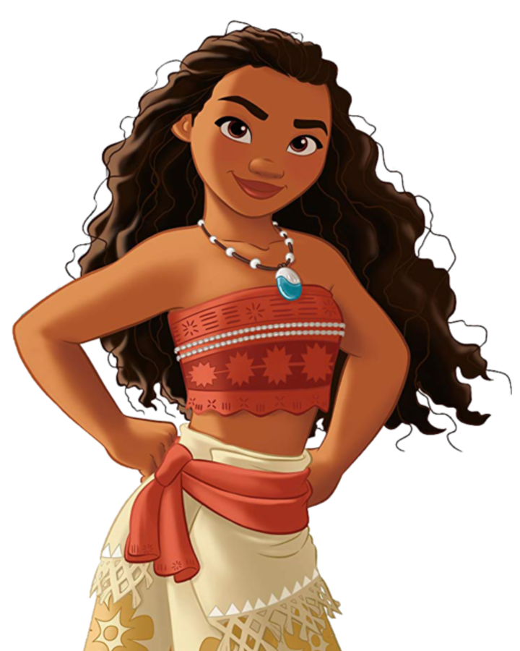

Slide 39
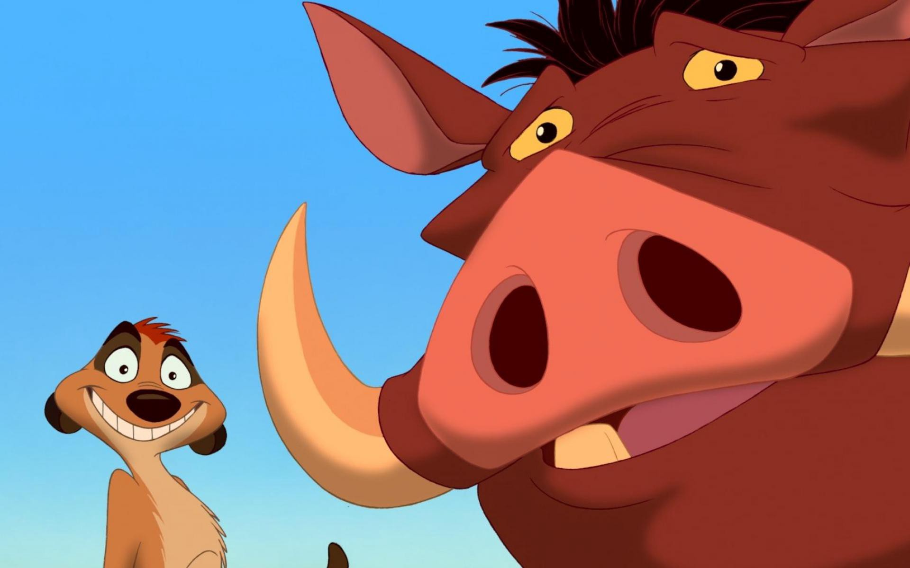

Slide 40
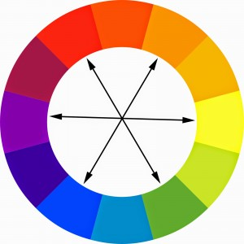
Complimentary Colors Red/Green – Orange/Blue – Yellow/Purple
Complimentary colors are
across from each other on a color wheel.

Slide 41
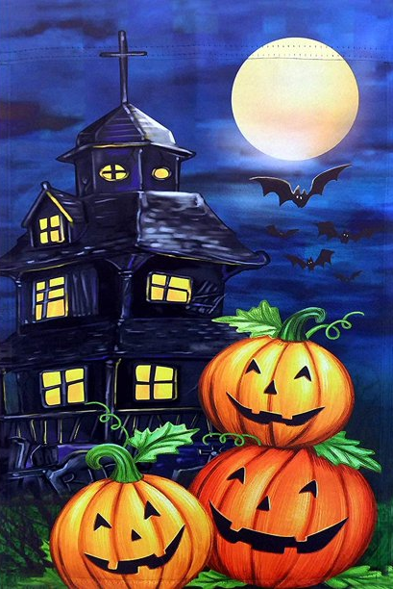
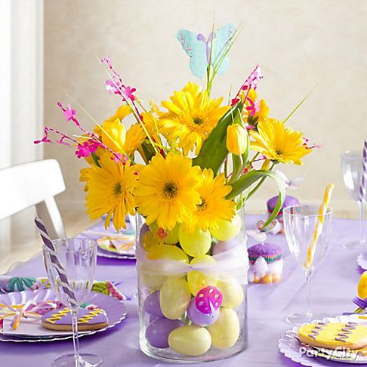
They Compliment Each Other Check out all of these famous holidays that show these colors off
Red/Green
Yellow/Purple
Orange/Blue

Slide 42
List as many Disney characters that you can think of that are mostly Red/Green – Orange/Blue – Yellow/Purple. You may also choose characters and their friends from the same film.
1.
2.
3.
4.
5.

Slide 43
Red/Green

Slide 44
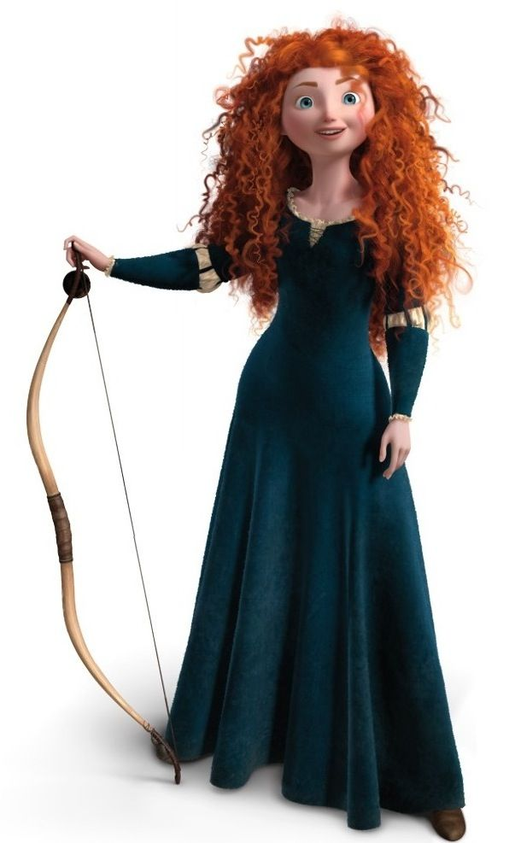

Slide 45
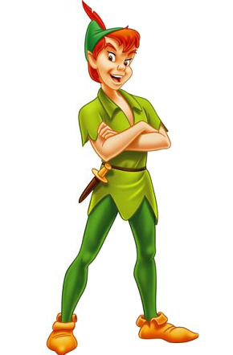

Slide 46
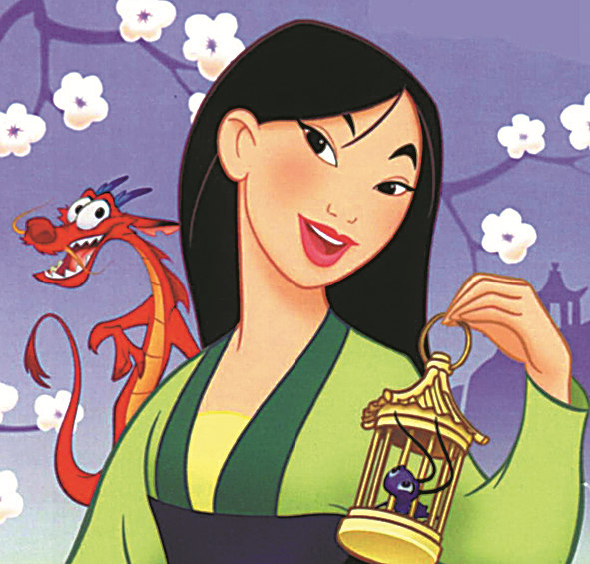

Slide 47
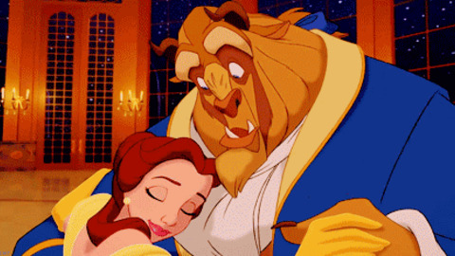
Orange/Blue

Slide 48
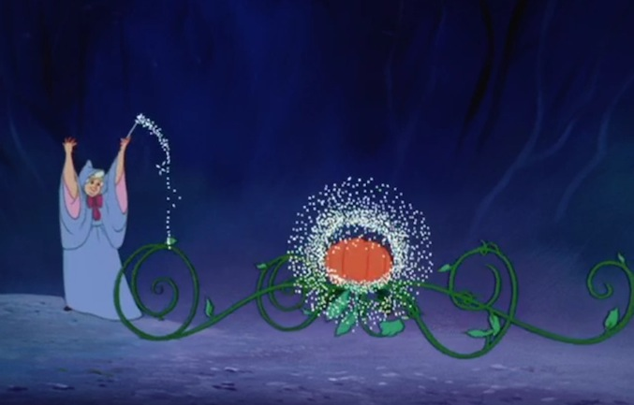

Slide 49
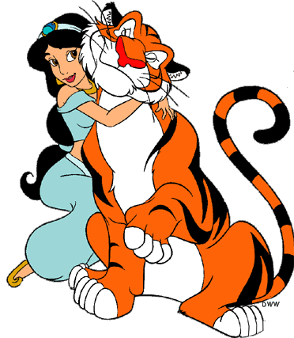

Slide 51
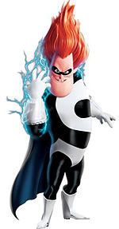

Slide 52
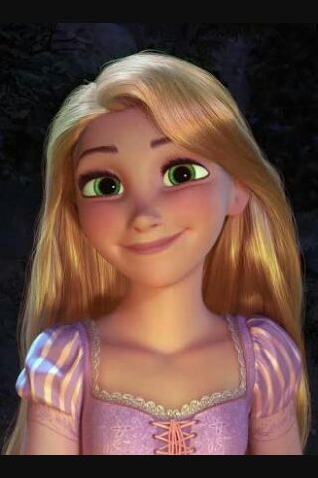
Yellow/Purple

Slide 54
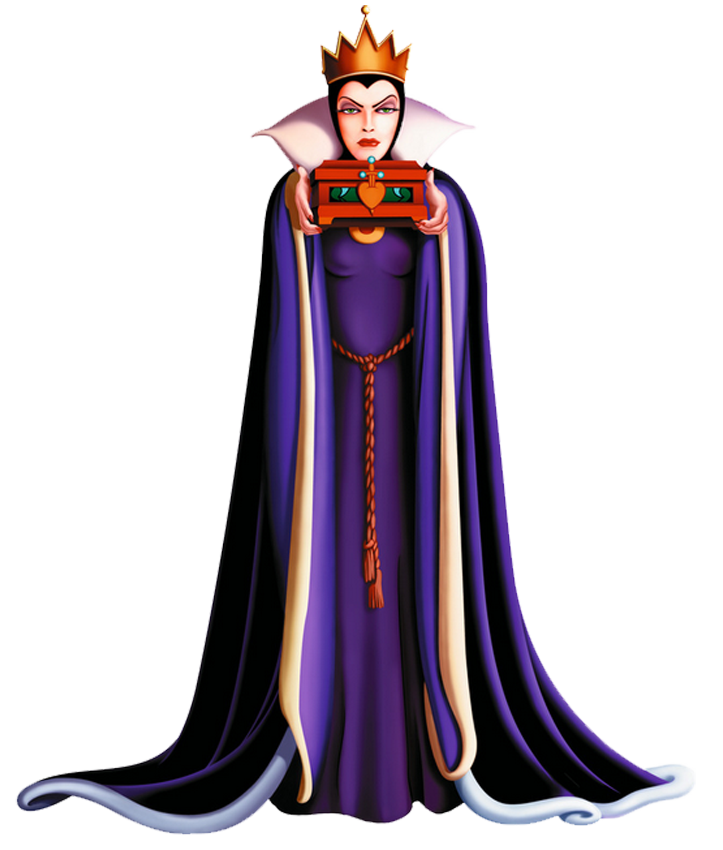

Slide 55
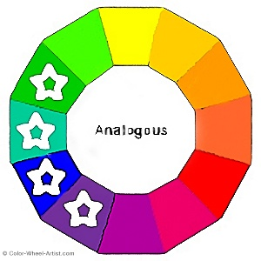
Analogous Colors are next to each other on the color wheel
Usually three to five colors main colors
in order on the color wheel

Slide 56
Check out this guide on each slide and see if you can find the colors next to each other in order in each image

