Slide 1
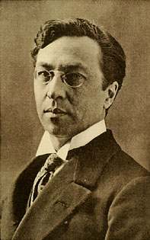
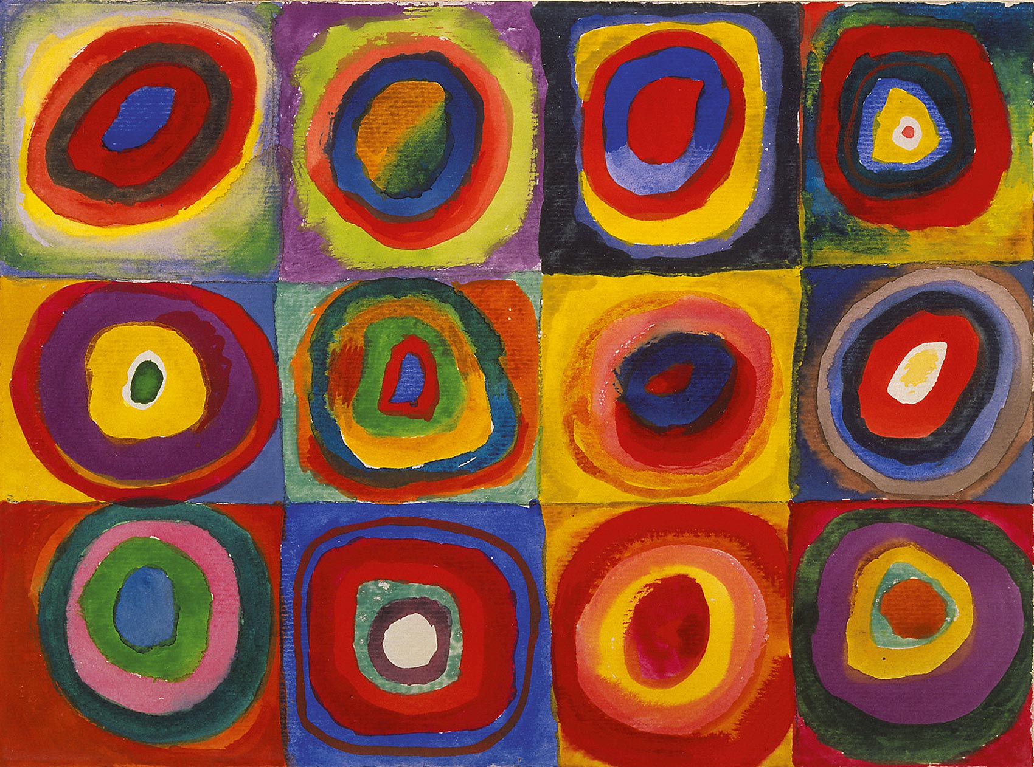
Wassily Kandinsky (Vass – ily or Vas-sily Can – din – skee)

Slide 2
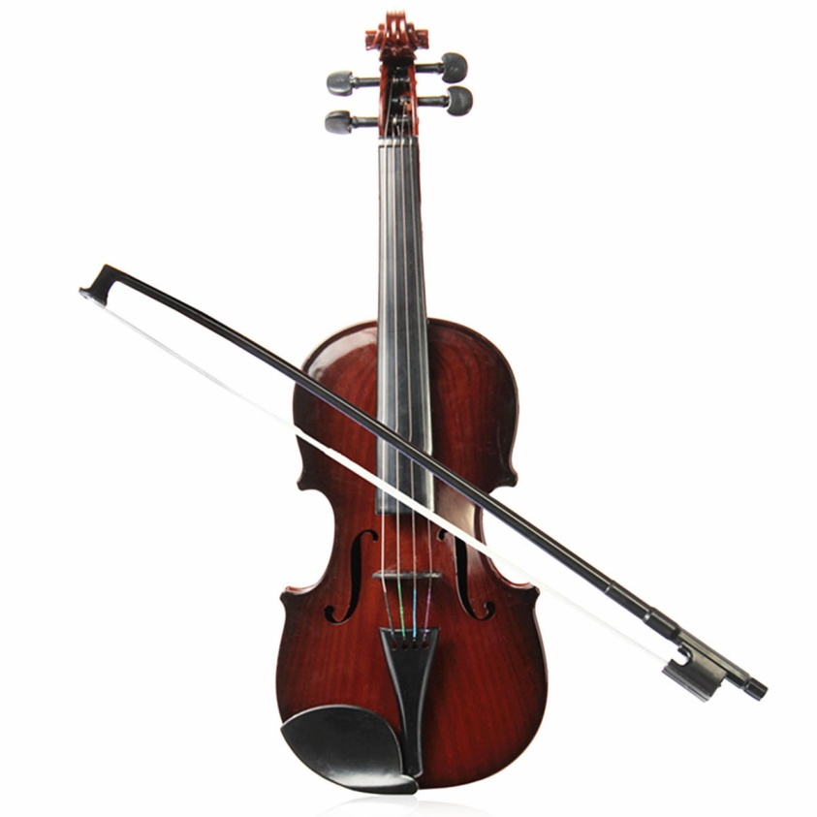
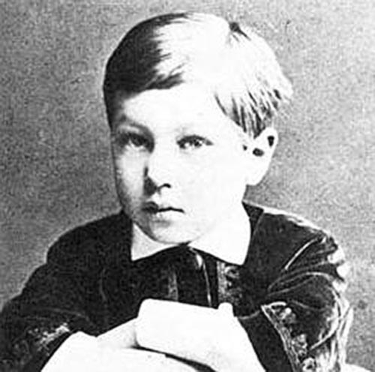
Kandinsky
Born in Moscow, Russia 1866 (over 150 years ago)
Very intelligent played the violin by age ten

Slide 3
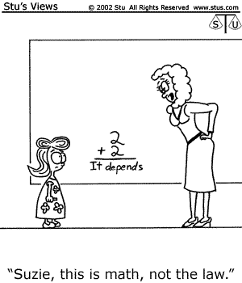
He went to college and became a law professor
This likely helped him question and see many perspectives, or ways of looking at things

Slide 4
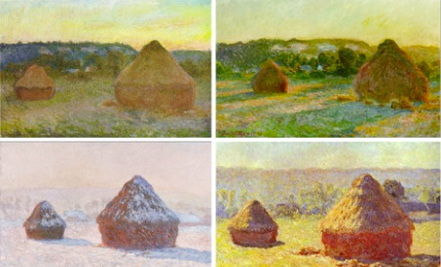
Was inspired when he first saw paintings by Claude Monet that looked unfinished
He noticed that the color and form created feeling - Not the items themselves

Slide 5
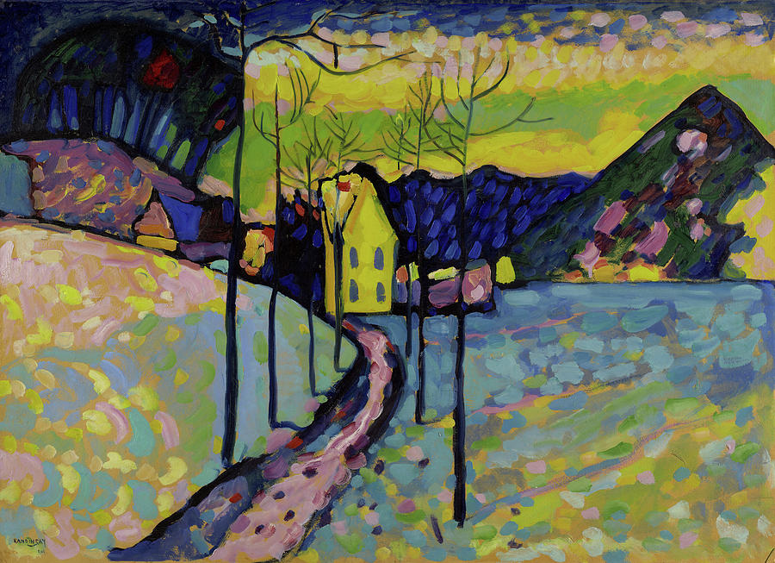
Inspired him to want to go to art school
In 1903 moved to Germany and started to explore the use of color
Maybe grass can be pink or blue?

Slide 6
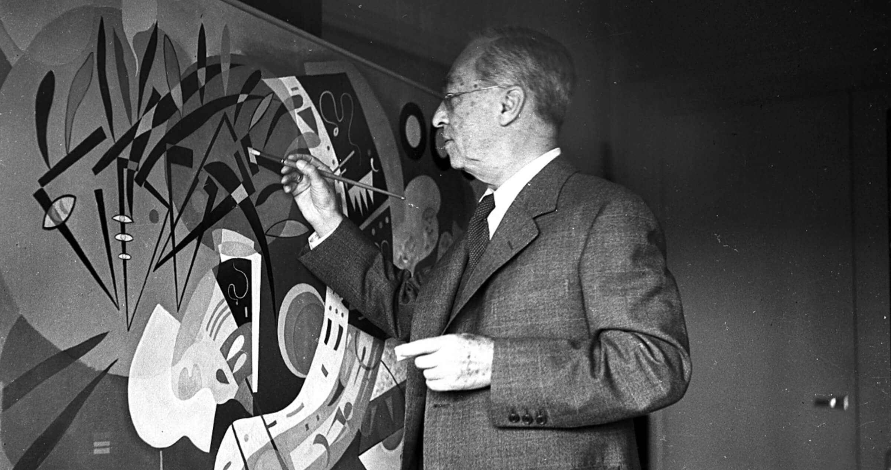
Often painted while wearing a suit wanted to look professional and smart at all times

Slide 7
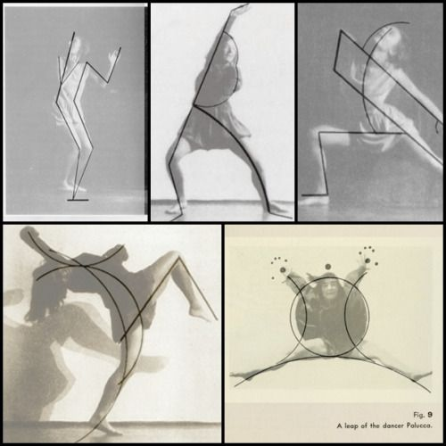
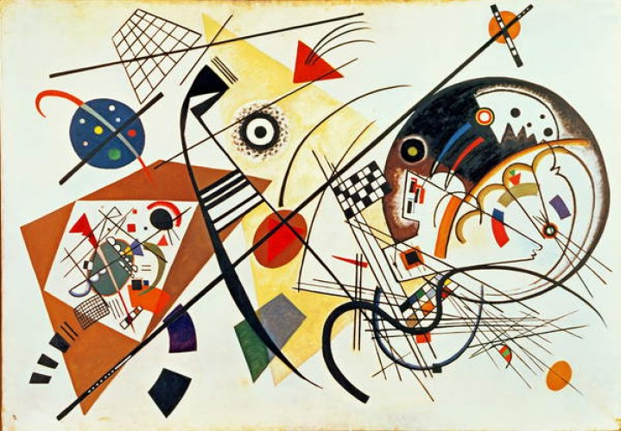
Along with a group of other artist friends start connecting painting with spirituality
He also had developed his own style of drawing
All arts are connected

Slide 8
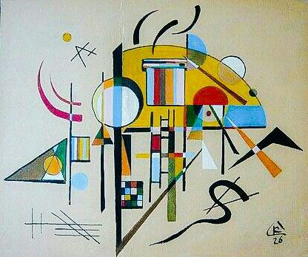
He also started connecting painting with music
By 1915 he started teaching other artists about how to play with color, and link painting with music

Slide 9
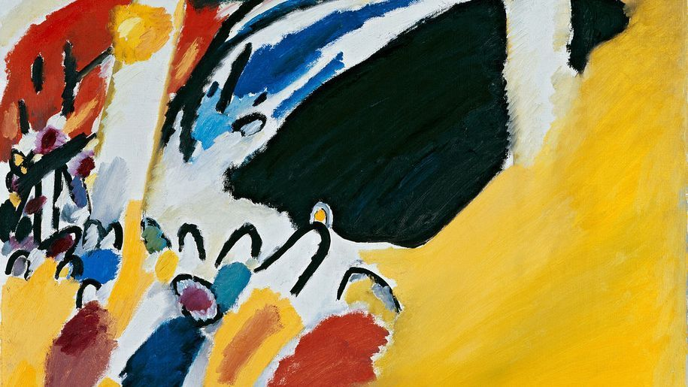
He was born with a harmless but fascinating condition called Synesthesia
Meaning he could use more than one sense at the same time
When he could hear sounds he could see color
When he could see color he could hear sounds

Slide 10
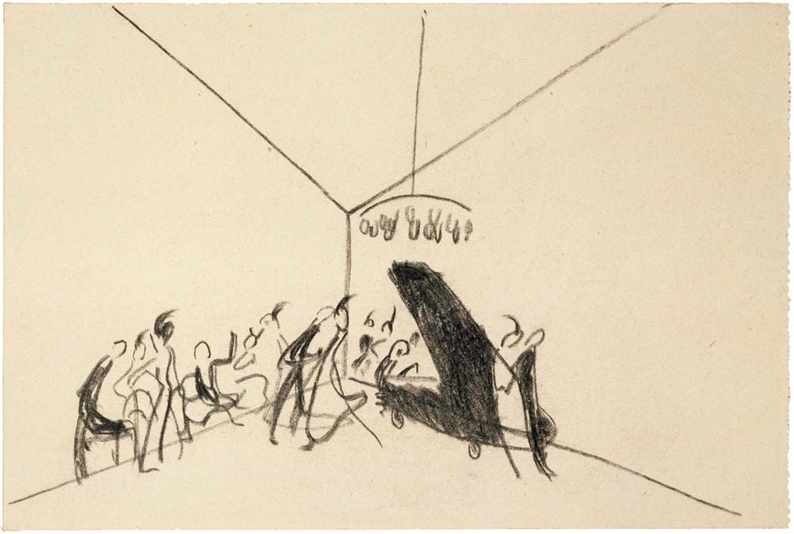

Slide 11
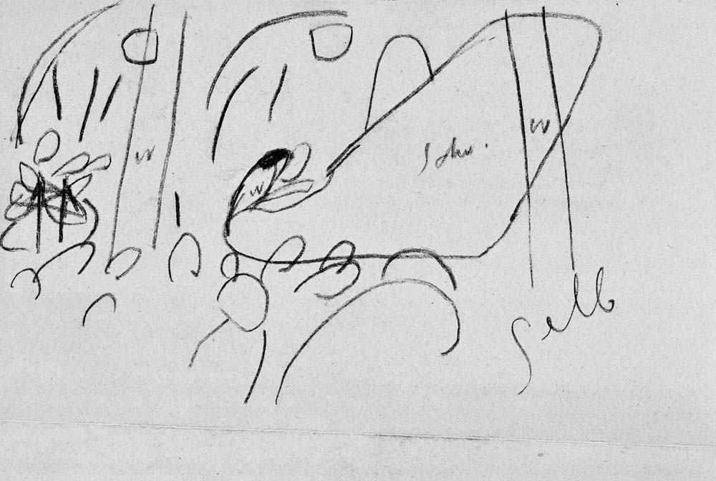

Slide 12
Impression III (Concert)

Slide 13
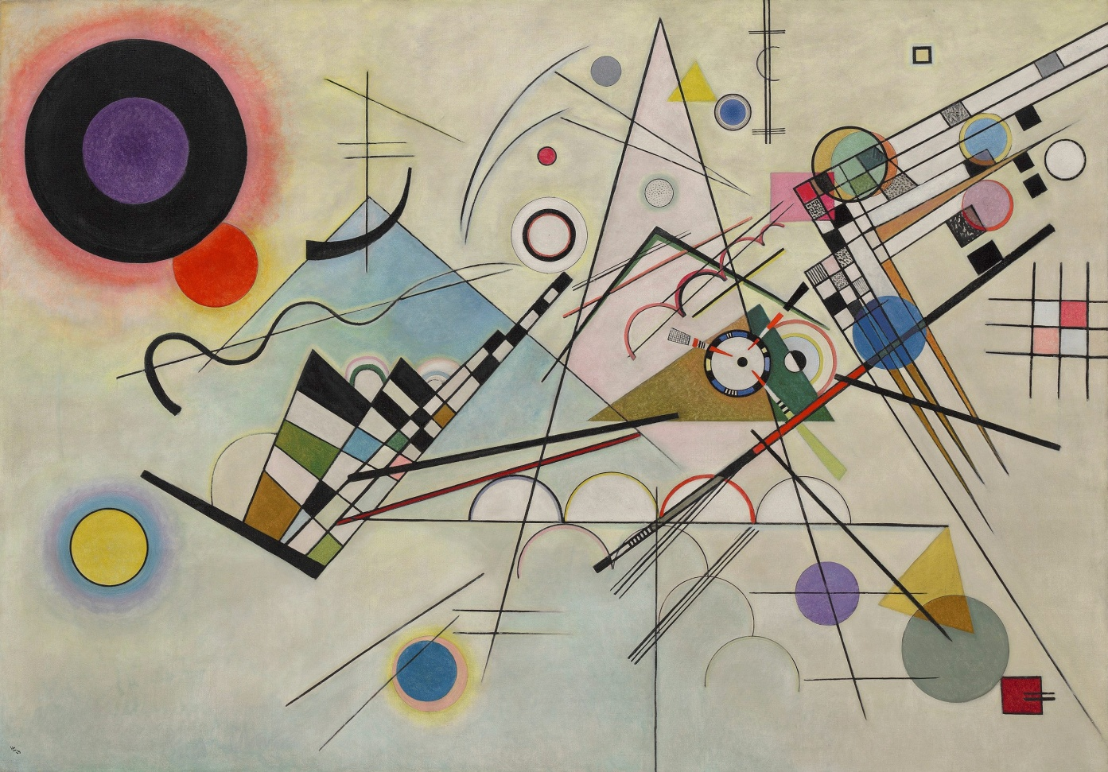
Composition VIII
https://www.youtube.com/watch?v=aWjRlBF91Mk&list=PLQKLR8OmizLZP6NNt45Be_oG3pH5OahuE&index=117&t=0s

Slide 14
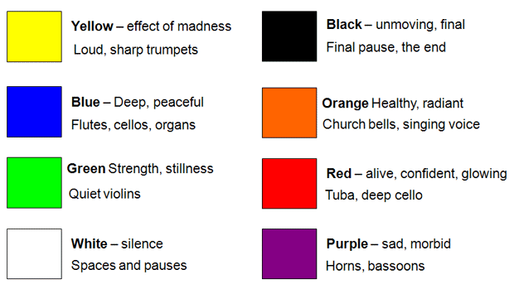
Wanted to paint from his soul created a guide for how he saw each color

Slide 15
Listen and Draw
Flute
https://www.youtube.com/watch?v=be1jJCH32OU&list=PLQKLR8OmizLZP6NNt45Be_oG3pH5OahuE&index=119&t=0s
https://www.youtube.com/watch?v=LI3wIHFQkAk&list=PLQKLR8OmizLZP6NNt45Be_oG3pH5OahuE&index=120&t=0s
Trumpet
https://www.youtube.com/watch?v=Cy5U-E_4E5E&list=PLQKLR8OmizLZP6NNt45Be_oG3pH5OahuE&index=121&t=19s
Drums
https://www.youtube.com/watch?v=ZagsLrNzg3I&list=PLQKLR8OmizLZP6NNt45Be_oG3pH5OahuE&index=122&t=0s
https://www.youtube.com/watch?v=MHj9XlV3fFg
Harp
https://www.youtube.com/watch?v=dCvEgqePl84&list=PLQKLR8OmizLZP6NNt45Be_oG3pH5OahuE&index=123&t=23s
Mozart Piano concerto No.23 A major 1st. movement
https://www.youtube.com/watch?v=4nZ_qkeffY4&list=PLQKLR8OmizLZP6NNt45Be_oG3pH5OahuE&index=124&t=0s

Slide 16
Make your own Kandinsky music
Chrome Music Lab – Kandinsky
https://musiclab.chromeexperiments.com/Kandinsky/

