Slide 1
Mixed Media

Slide 2
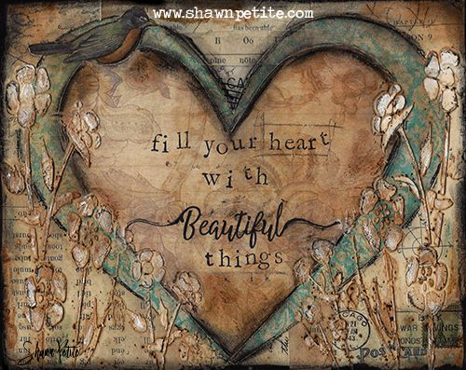
Defining Mixed Media
Using a variety of “things” in one single art piece
Artworks composed from a combination of different media or materials
a combination of backgrounds, layers, embellishments, your focal point, watercolors, acrylics, water-soluble oil sticks, pastels, inks
on a substrate, which could be a canvas, masonite panel, birch panel, art journal, canvas paper etc.

Slide 3
Compare these two pieces Both are considered to be of the first types of mixed media to be considered real art. What do you notice about how they are the same and how they are different. What types of things do you think each artist used to make their piece?
Pablo Picasso, Guitar, 1913
Georges Braque, Violin and Sheet Music, 1913

Slide 4
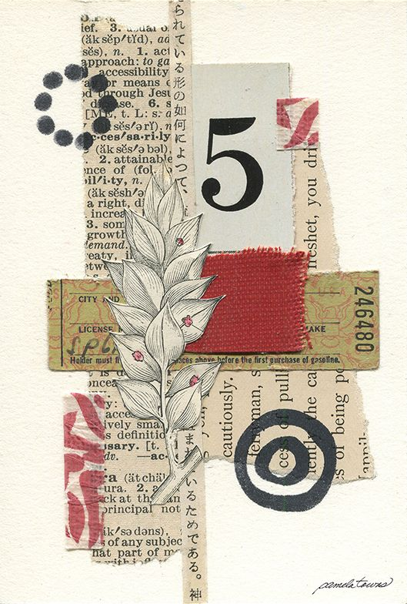
What do you think this artist used in this piece of art? How many different types of things can you find?
What is the thing you noticed first?

Slide 5
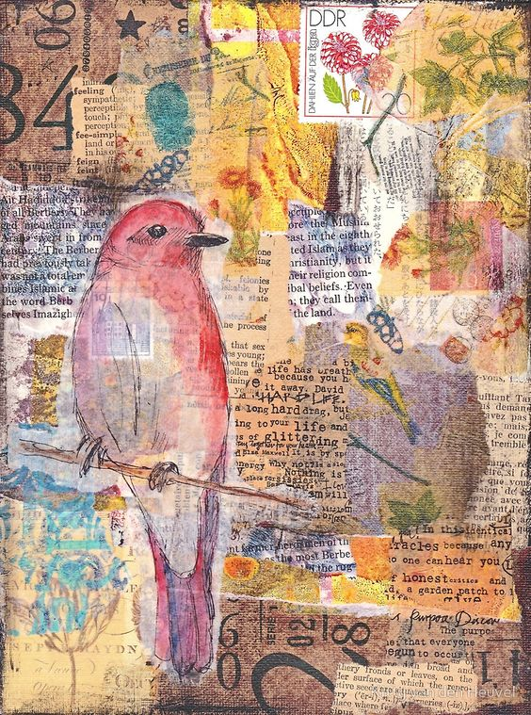
Look at this very different type of Mixed Media Artwork. How many different things did this artist use? Did this artist lay out their items separately or overlap them?

Slide 6
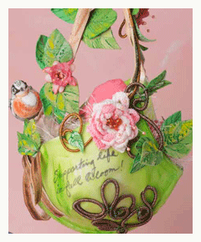
On the website, clothpaperscissors.com They list the “rules” for making Mixed Media Art
1. A love of variety. (mediums/media/techniques)
2. A willingness to get messy.
3. As Dumbledore once said of Harry Potter, “A certain disregard for the rules.”
4. A passion for the sensory.
Mixed-media artists love to touch, smell, and practically eat with their eyes.
5. An open mind.

Slide 7
Things to think about…
The next slides are some more examples of different types of Mixed Media Art.
Think about how you will make your own art.
Will you cut or tear your paper?
Will you use magazines or newspapers?
Will you draw, paint, color, glue, stamp?
Will you use typed words or write your own?

Slide 8
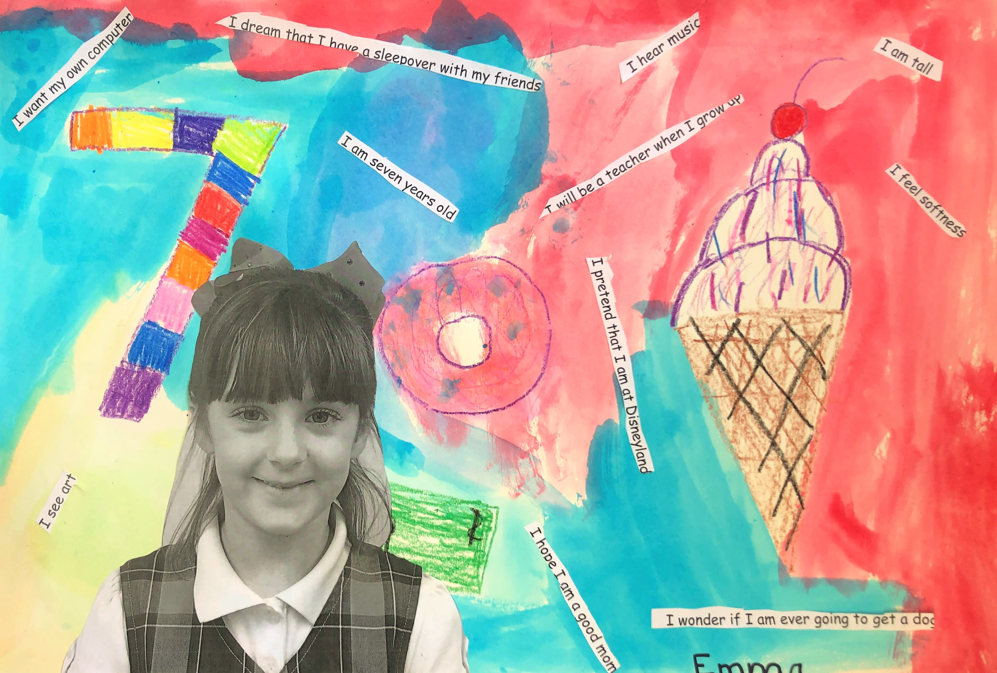
Anyone can make Mixed Media Art. Use your imagination!

Slide 9
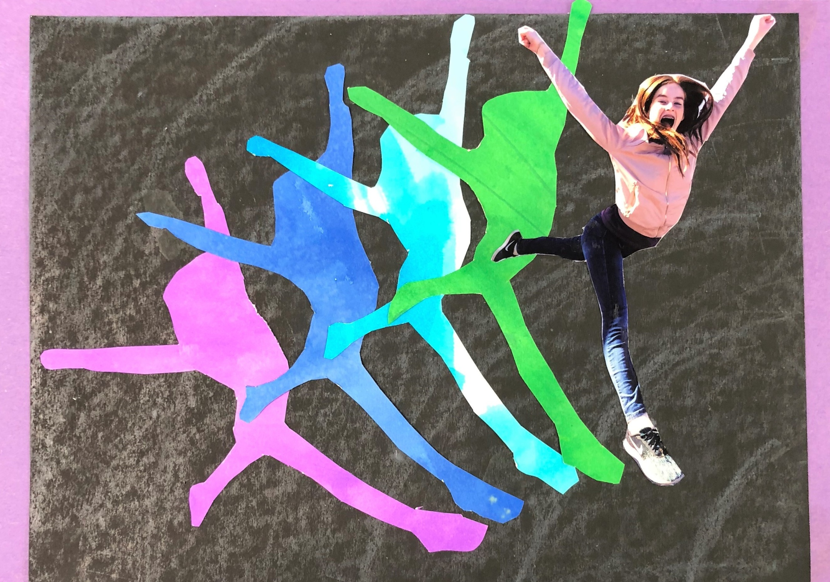

Slide 10
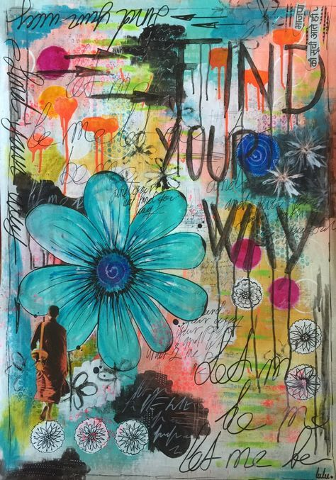

Slide 11
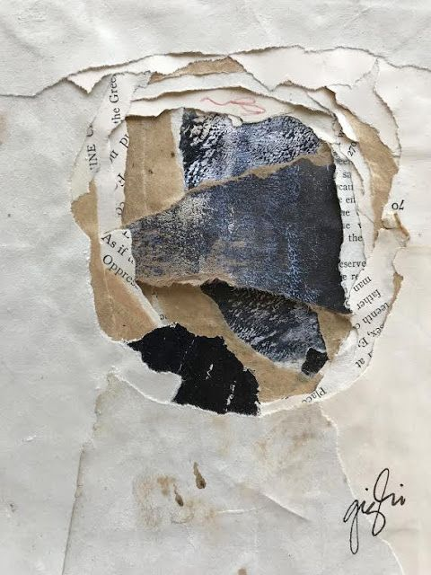
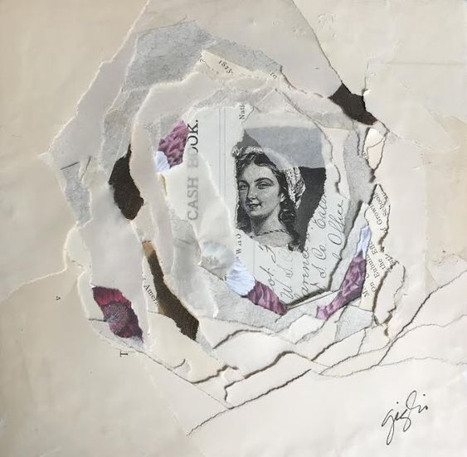

Slide 12
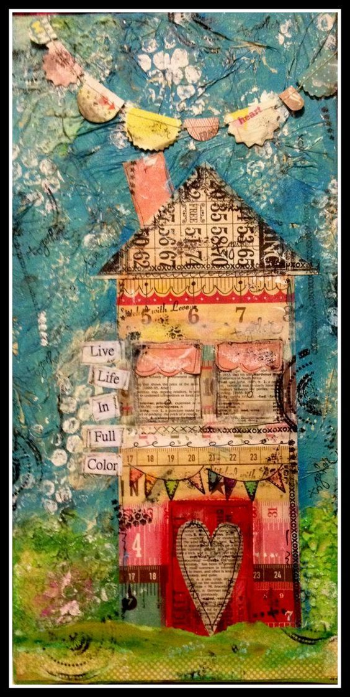

Slide 13
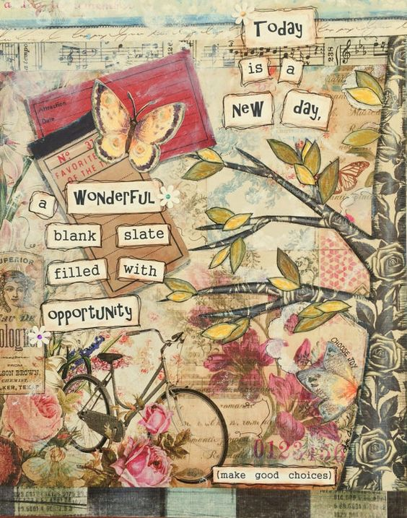
How to get started
Pick Your Base
(Paper, Canvas)
Pick a Background
Glued paper? Paint?
Something behind everything else
Add Texture
Pick a Focal Point
(what do you want them to notice first?)
Sprinkle Around Some Embellishments
Add a Quote or Sentiment (optional)
Finish the Edges (optional)

Slide 14
Play and Have Fun!

