Slide 1
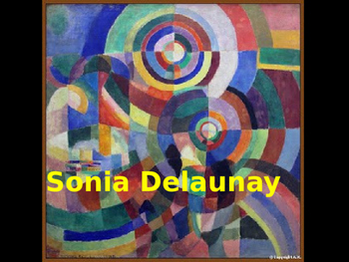
Prismes électriques (Electric Prisms) (1914)

Slide 2
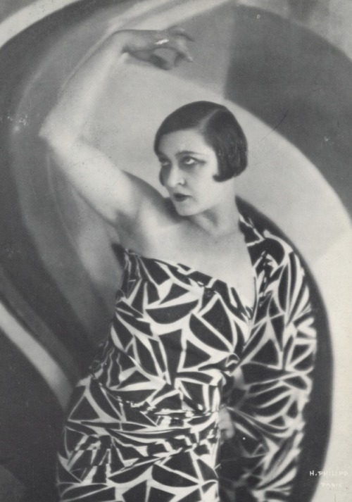
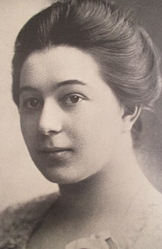
Born: November 14, 1885 Died: December 5, 1979 Married to famous Art Master Robert Delaunay

Slide 3
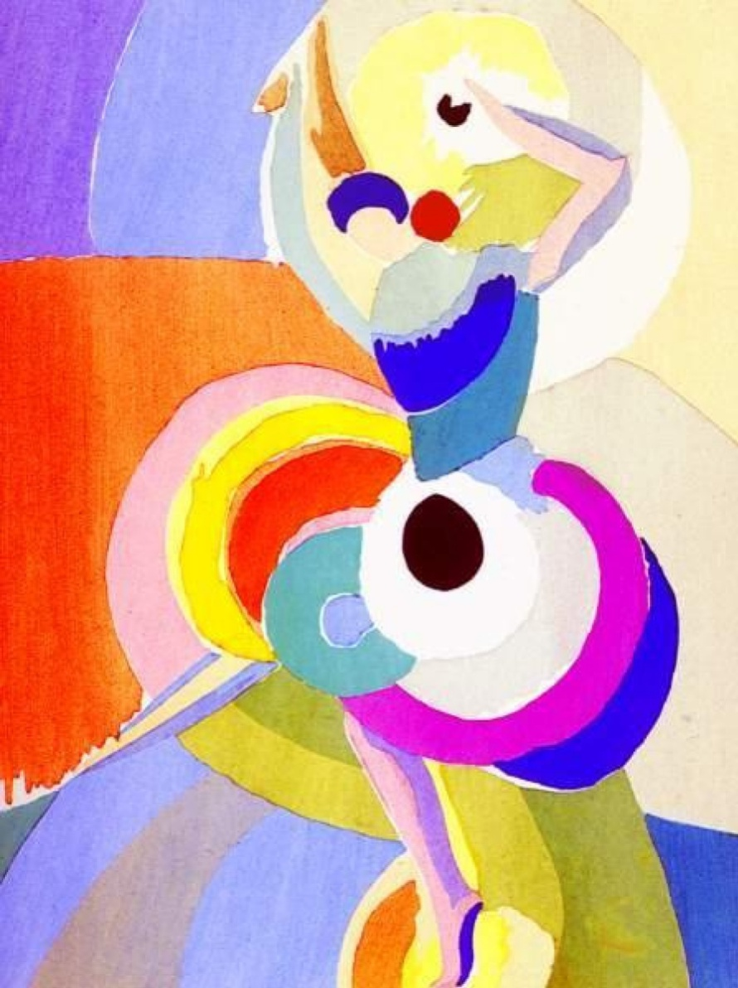
Sonia created art using painting, set and textile design in
Furniture
Fabrics
Wall coverings
Clothing
She designed them using something called geometric abstraction
Geometry is all about lines, shapes and angles. Think of some basic shapes – squares, triangles, circles, rectangles. Some artists use these shapes to build, draw and design their artwork.
Abstraction is when you create art that is not focused on making something look real. It is all about lines and shapes and colors.
"Flamenco Dancer" 1916

Slide 4
For 1300 years art was only considered valued if there were realistic looking things. Artists often painted people or objects and focused on how light and shadows made the objects look 3-dimentional.

Slide 5
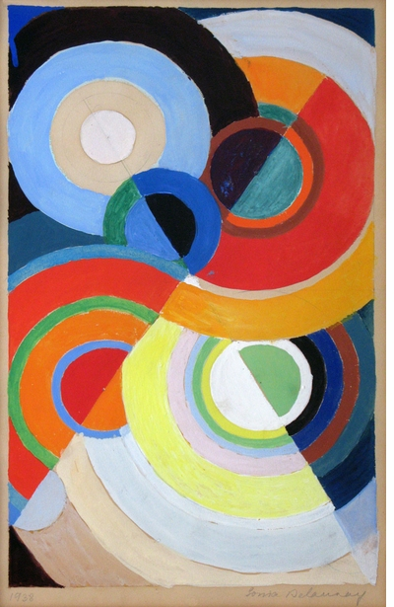
Nearly 150 years ago, artist started changing the way we look at art. They started focusing on concepts and non-realistic looking things. Instead of focusing on the skill of light and shadows, they focused more on emotions and colors. Check out this artwork from Sonia Delaunay. It meant one thing to her. But the longer you look at it, it may mean something different to you. And it might make you feel a certain way by looking at it.
Gouache, 1938

Slide 6
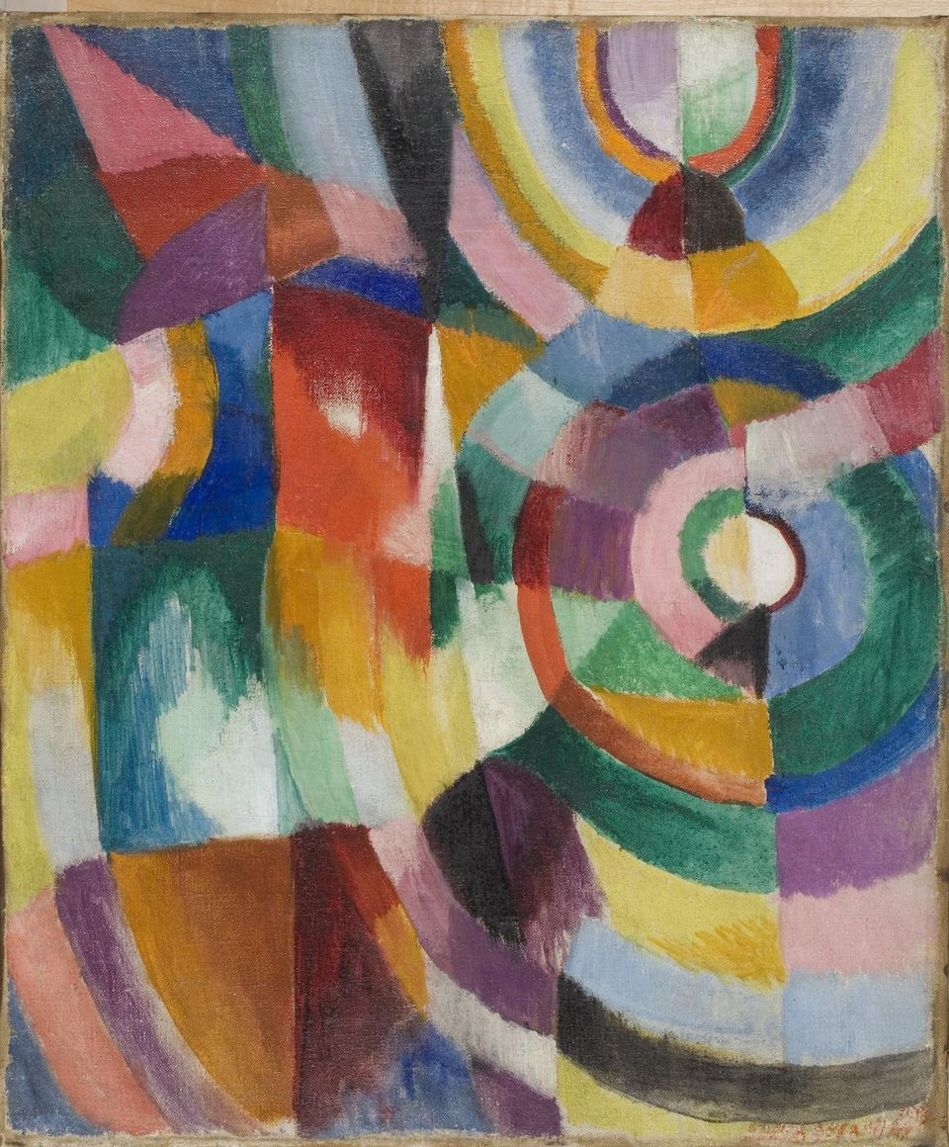
There were two important styles of art at the time Sonia made her artwork. Orphism 1912 Cubism 1904-1917 Both styles focused on strong colors and geometric shapes

Slide 7
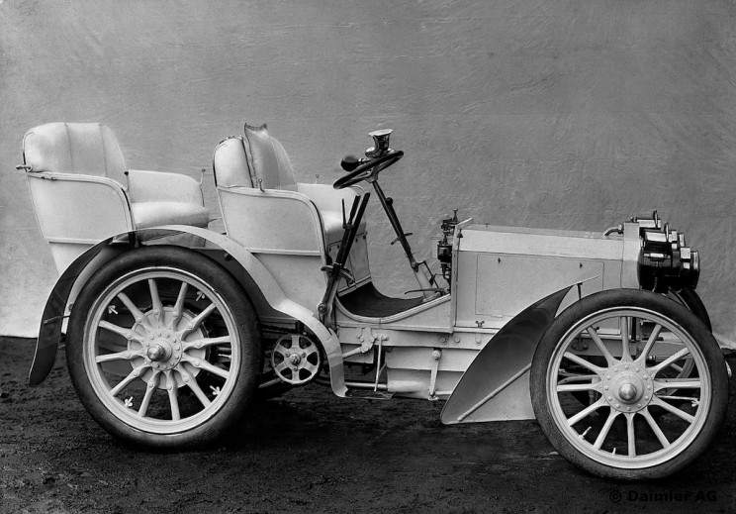
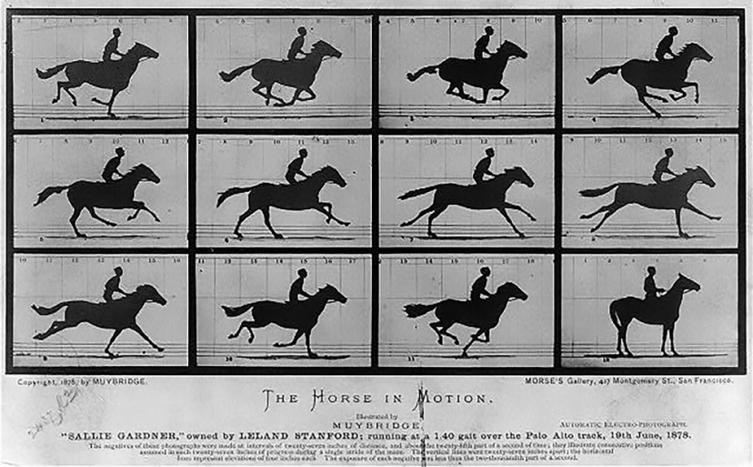
What inspired her artwork?
At the beginning of the 1900’s many new inventions were changing in the world. Not only was transportation moving faster with the invention of the car, motion pictures were exploring how images could move on a reel to make movies. Sonia loved the idea of making artwork that felt like it was moving.

Slide 8
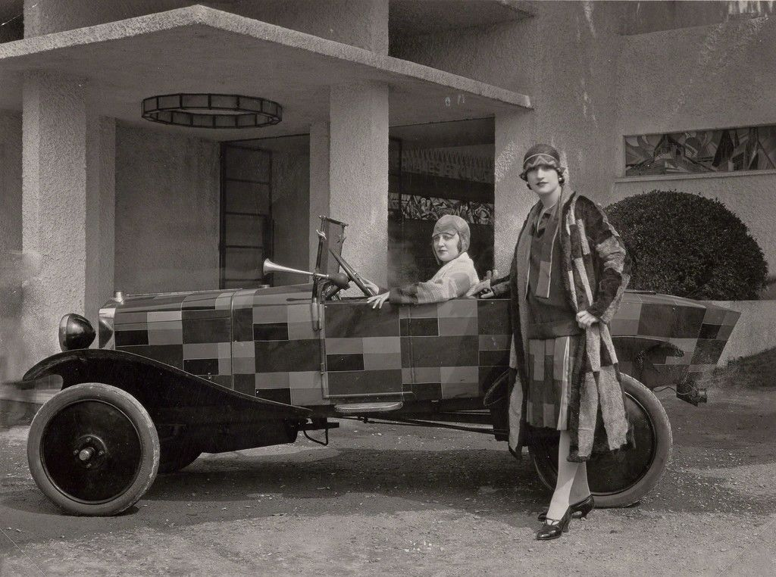
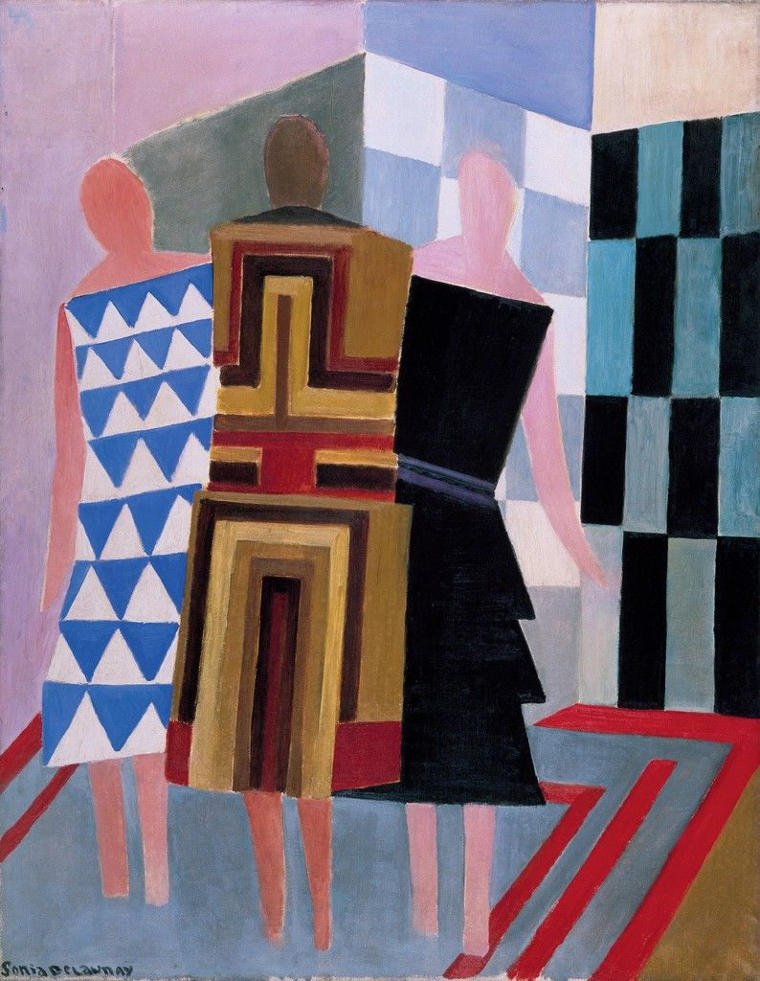
Huge impact on the styles of the 1920’s
Check out this car and outfits designed by Sonia. She created rhythm, motion and depth through overlapping patches of vibrant hues (colors).
Ballets Russes

Slide 9
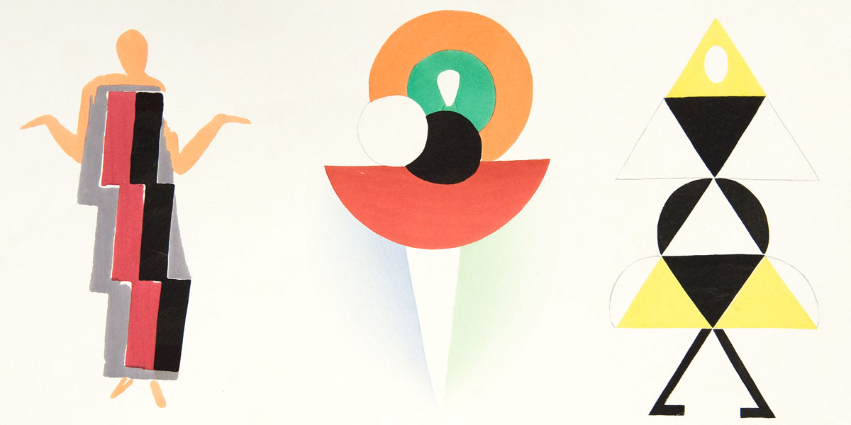
This is how Sonia drew design ideas for clothing.
This drawing is artwork all itself.

Slide 10
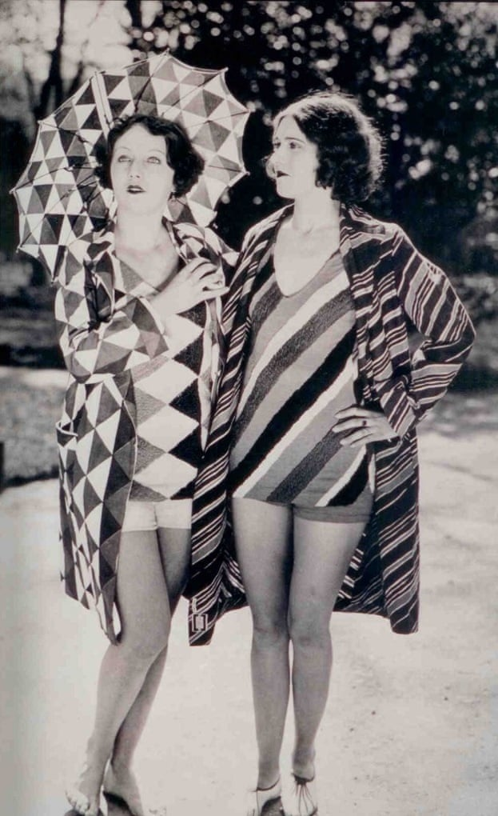
“Painting is a form of poetry, colors are words, their relations rhythms, the completed painting a completed poem.”
-Sonia Delaunay

Slide 11
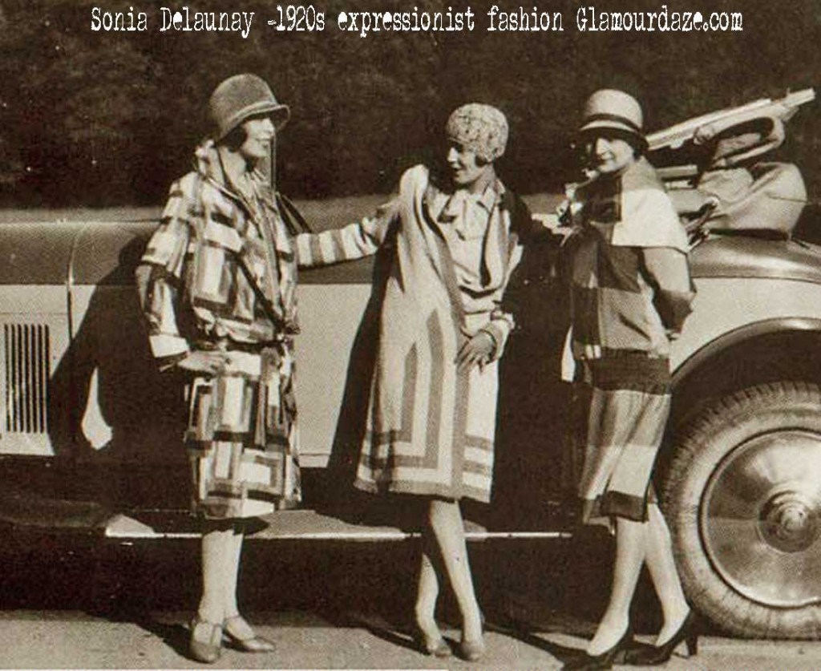
Whenever we see people dressed like this, we know the time period was the 1920’s. And they are dressed like this all because of Sonia.

Slide 12
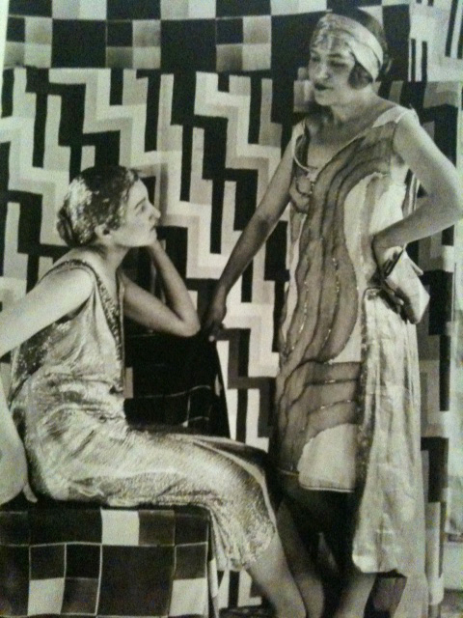
Not everyone liked her artwork. Critics were not impressed that things like clothing, wallpaper and furniture was being called “art”; one said that her work was “at best, no more than decorative value”.
How would you feel if someone said your ideas weren’t valuable?

Slide 13
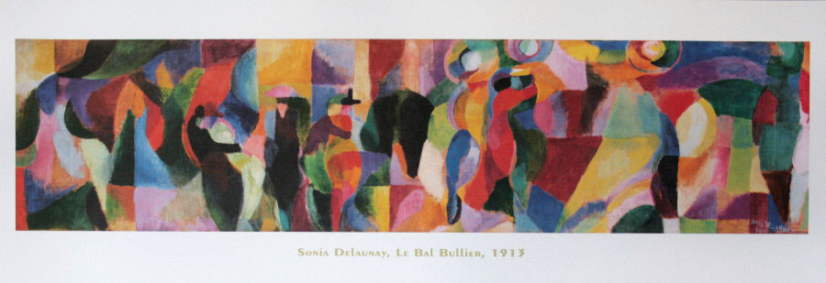
Le Bal Bullier (1913)
Le Bal Bullier is the name of a ballroom in Paris, France. Can you see all of the people dancing?

Slide 14
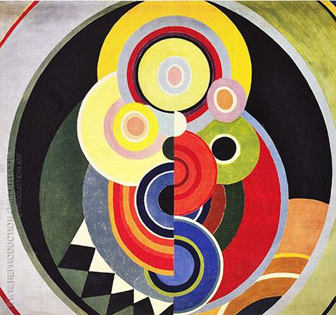
Salon des Tuileries (1938)
The Salon des Tuileries was an annual art exhibition for painting and sculpture. What do you think of when you look at this piece of art?

Slide 15
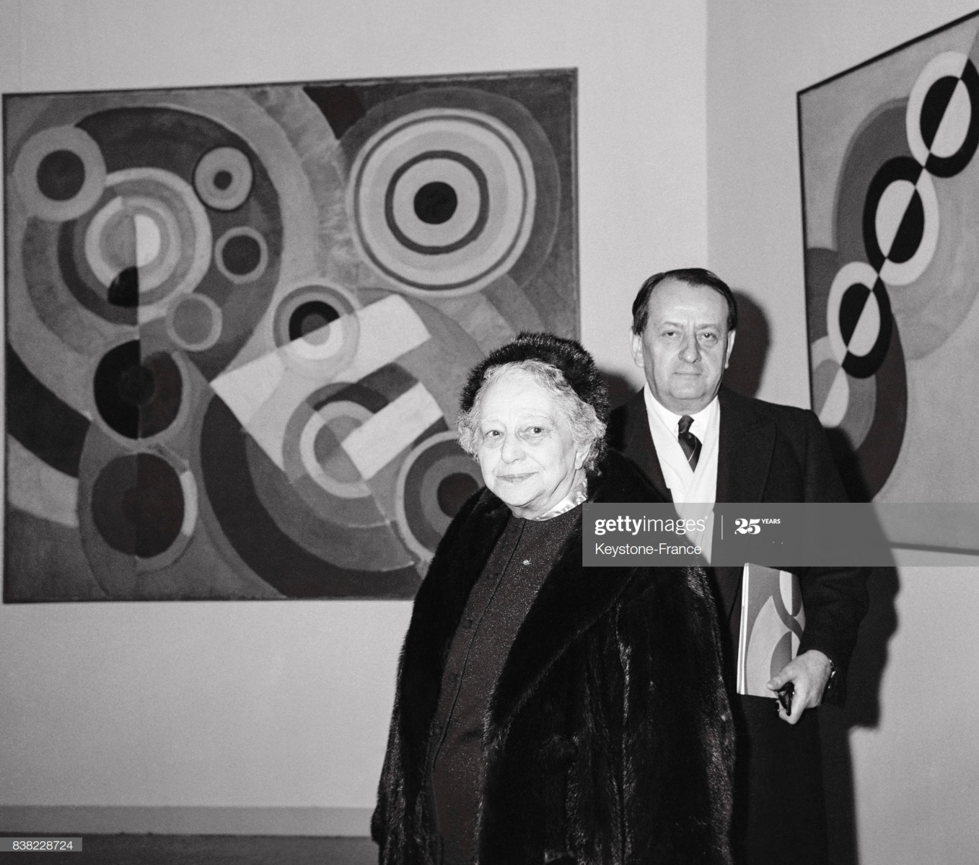
She was the first living female artist to have a retrospective (a sample of her artwork) exhibition at the Louvre in France in 1964. In 1975 she was given a special award with the French Legion of Honor.

Slide 16
Make your own Sonia Delaunay Art
The next slides will show some things to think about when making artwork that is in the style of Sonia Delaunay.
Look around your house for round items. Trace around different sized items to make a variety of circles.
Try to make some of them “concentric”: Meaning…make some of them with a circle in the center of another circle.

Slide 17
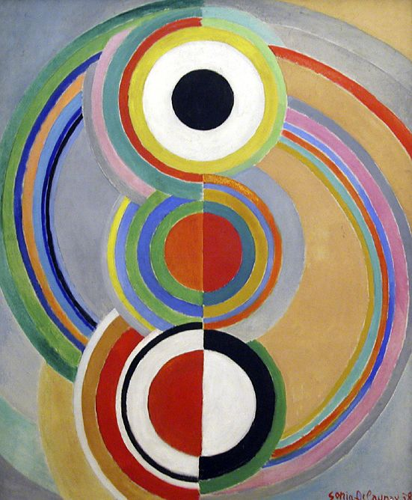
Rhythm, 1938
Look closely at this piece of art
How many lines are there approximately in this piece? And how many circles?
Where are the circles placed? Are they random? Do they touch a line? Is one circle inside of another circle?
When she drew the circles, did she connect them completely around, or are they ever broken in half?
Will colors connect across a line to complete the circles? Or, are colors different on either half of the line?
Do any colors lie next to each other? Is a color on one side of a shape painted directly on the other side of any line?
How does she incorporate achromatic (black, white, gray) colors?

Slide 18
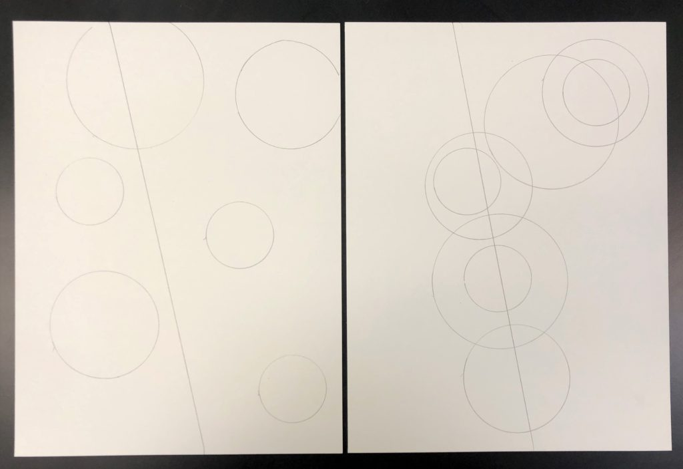
Make your own Sonia style artwork
Do I have too many or too few lines or circles?
How busy or simple is my drawing?
Looking at my circles, are they “floating by themselves” or are they connected to a line or another circle?

Slide 19
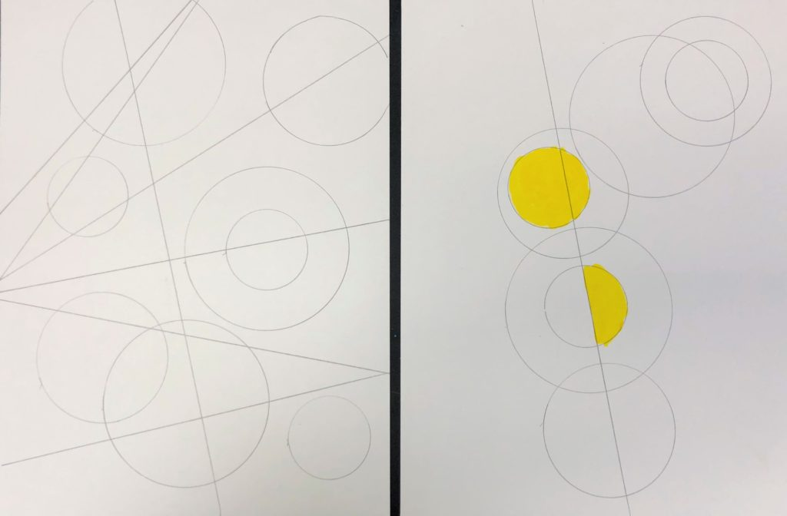
Did I create any circles that are broken in half?
Can I paint inside every area?
When painting my picture, where will my color start and stop?
How will I incorporate achromatic (black, white, gray) colors into my piece?

Slide 20
