Slide 1
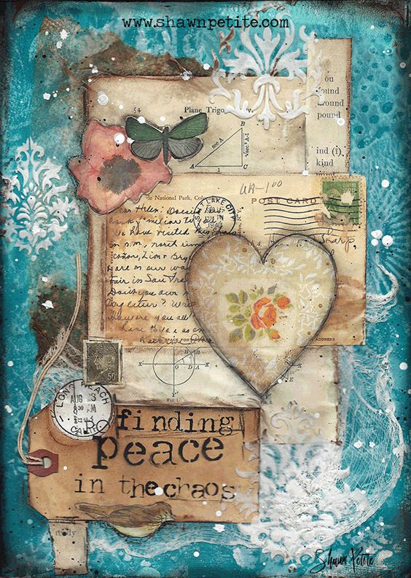
Mixed Media

Slide 2
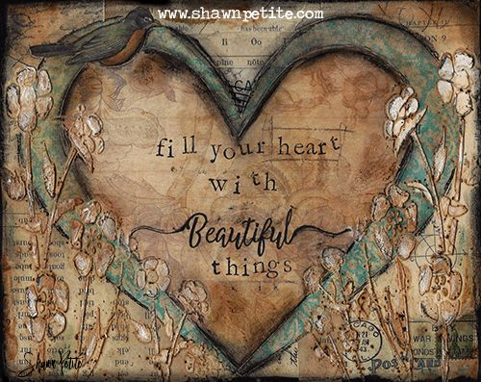
Defining Mixed Media
Using a variety of “things” in one single art piece
Artworks composed from a combination of different media or materials
a combination of backgrounds, layers, embellishments, your focal point, watercolors, acrylics, water-soluble oil sticks, pastels, inks
on a substrate, which could be a canvas, masonite panel, birch panel, art journal, canvas paper etc.

Slide 3
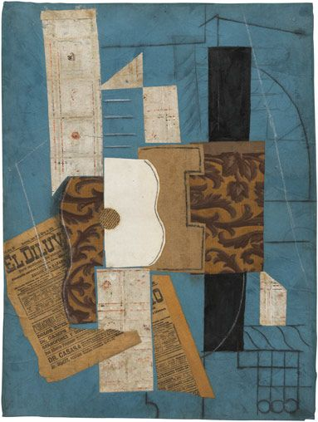
Pablo Picasso, Guitar, 1913

Slide 4
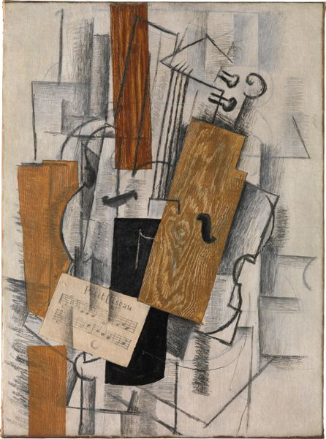
Georges Braque, Violin and Sheet Music, 1913

Slide 5
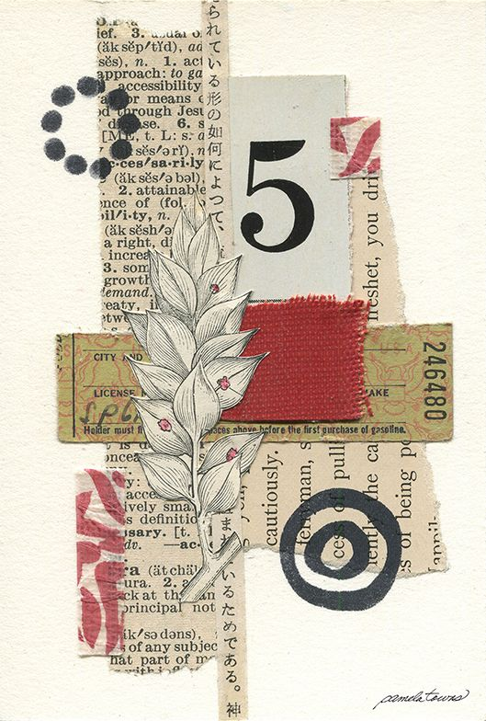

Slide 6
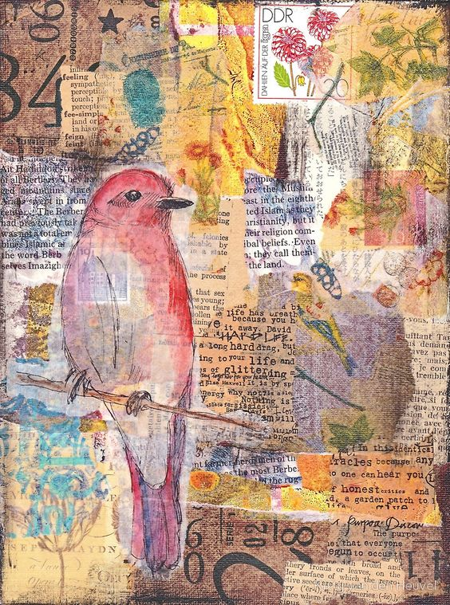

Slide 7
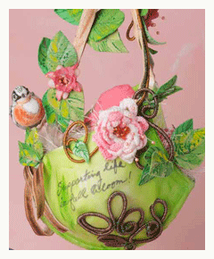
Rules from clothpaperscissors.com
1. A love of variety. (mediums/media/techniques)
2. A willingness to get messy.
3. As Dumbledore once said of Harry Potter, a certain disregard for the rules.
4. A passion for the sensory.
Mixed-media artists love to touch, smell, and practically eat with their eyes.
5. An open mind.

Slide 8
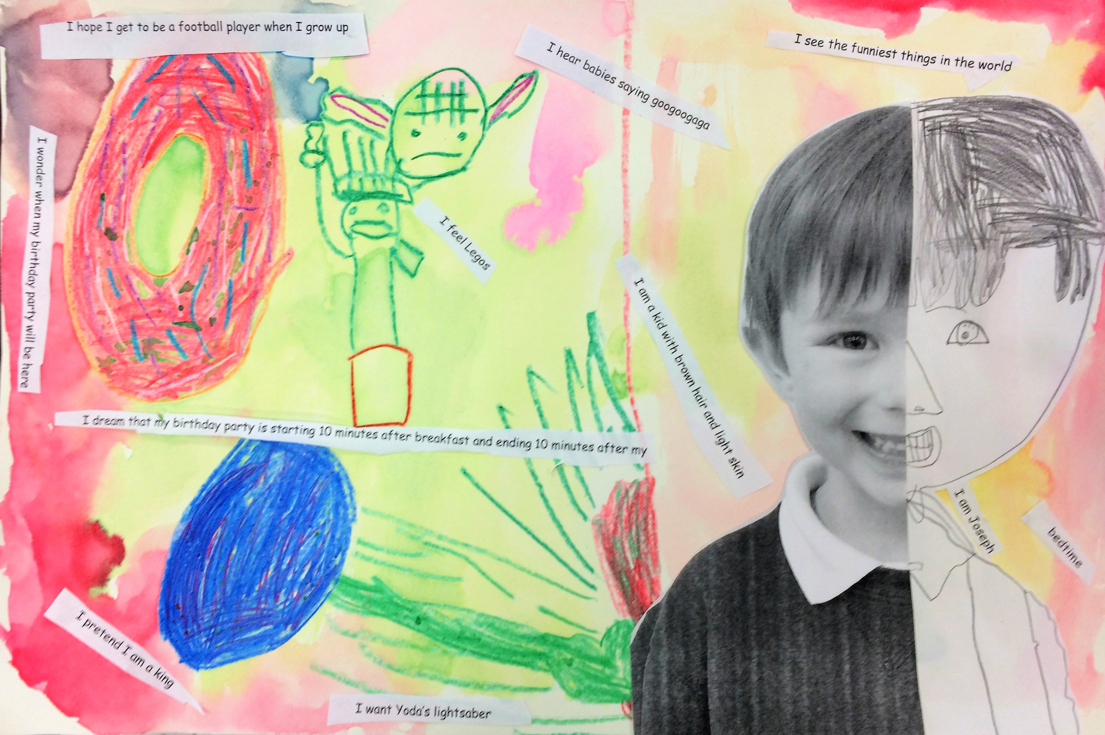

Slide 9
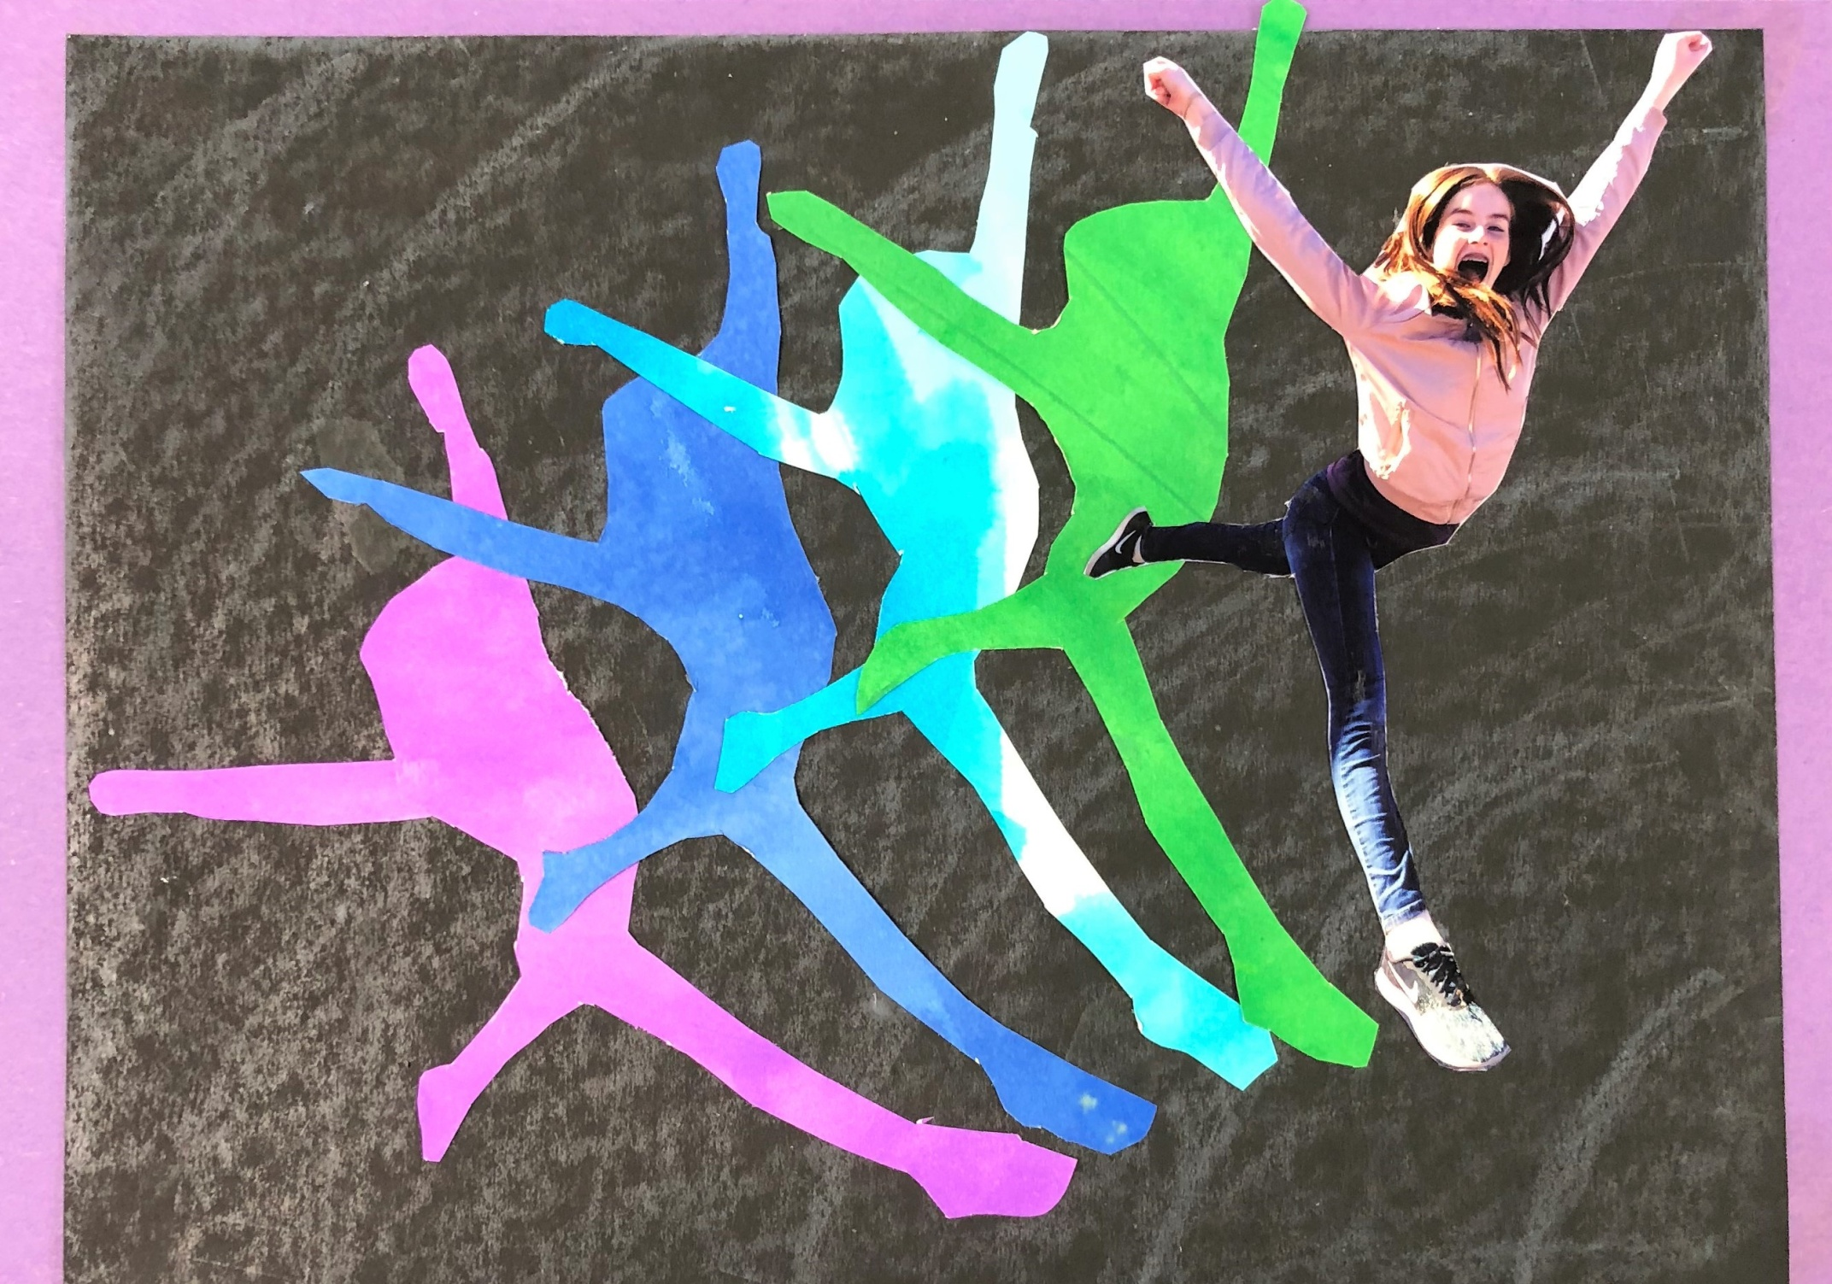

Slide 10
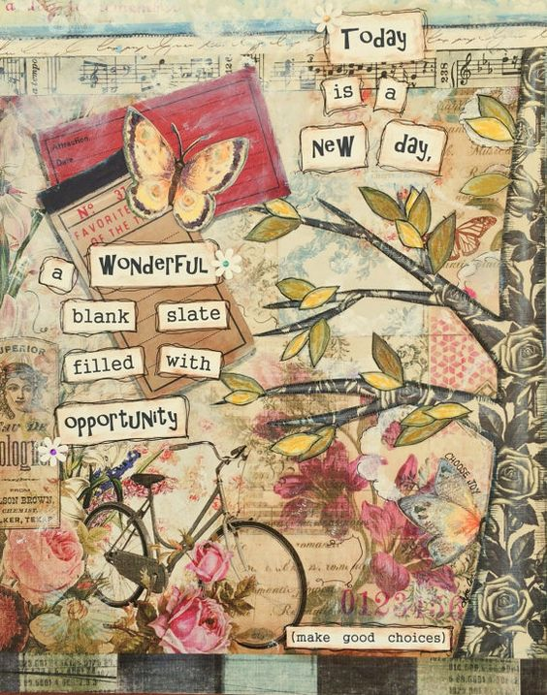
The Process
Pick Your Base
Pick a Background
Add Texture
Pick a Focal Point
Sprinkle Around Some Embellishments
Add a Quote or Sentiment (optional)
Finish the Edges (optional)

Slide 11
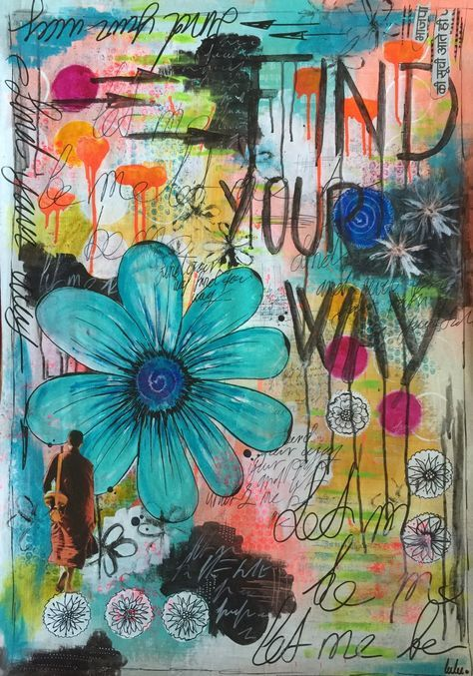

Slide 12
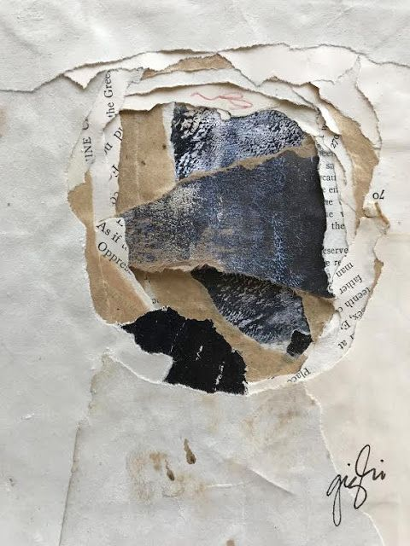
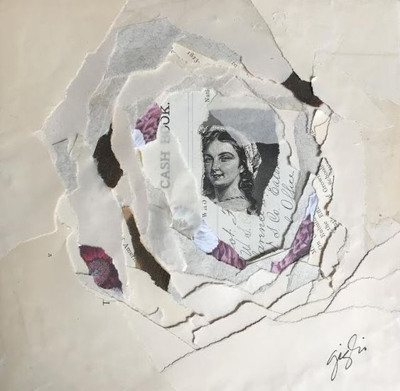

Slide 13
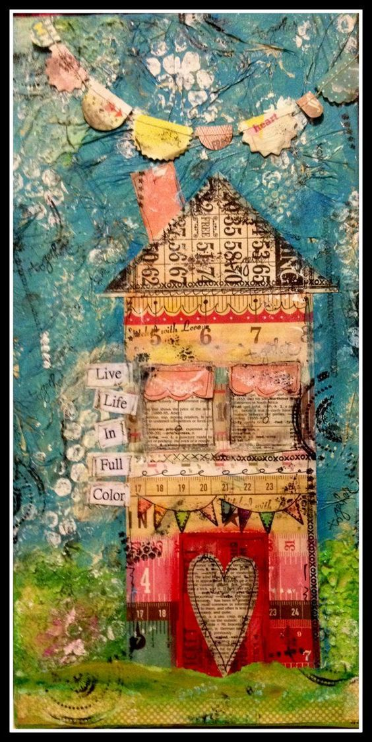

Slide 14
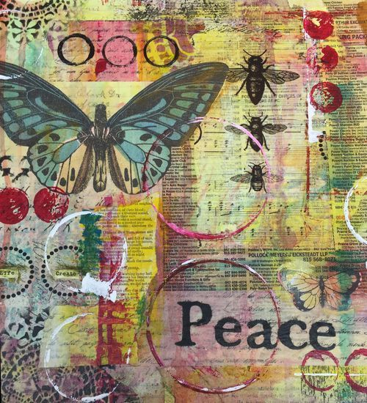
Play and Have Fun!

