Slide 1
Primary Colors

Slide 2
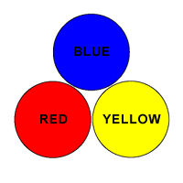
Red – Blue – Yellow

Slide 12
Secondary Colors

Slide 13
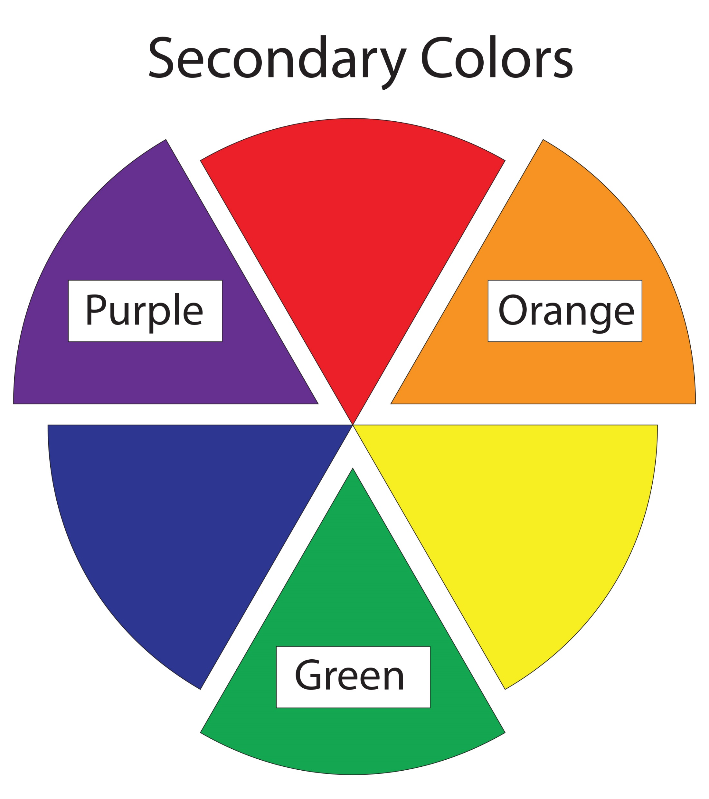
Orange – Green - Purple

Slide 23
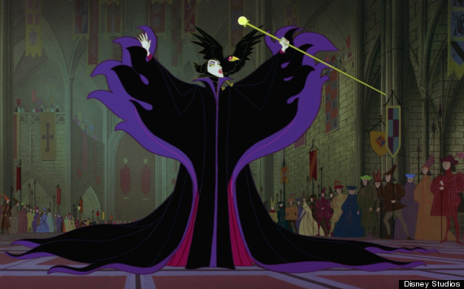

Slide 24
Neutral Colors

Slide 25
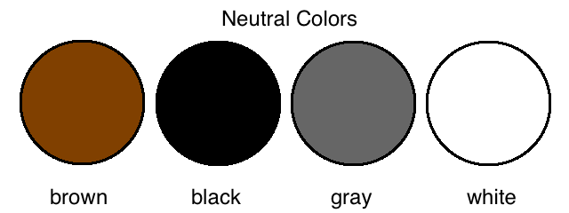
Brown – Black – Gray – White

Slide 26
Brown, Grey, Black, White

Slide 28
Complementary Colors

Slide 29
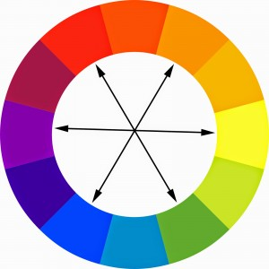
Opposite Colors

Slide 30
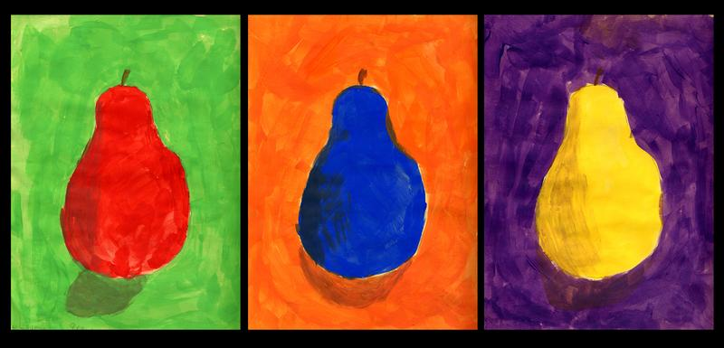
They Complement Each Other

Slide 31
Red - Green

Slide 35
Orange - Blue

Slide 41
Purple - Yellow

Slide 44
Analogous Colors

Slide 45
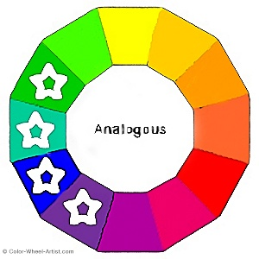
Colors next to each other on the color wheel

